Slide 1

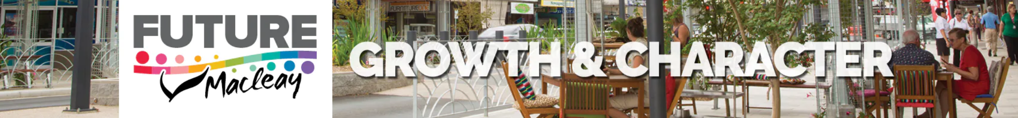
Local strategic planning statement
Community drop-in sessions
August 2020

Slide 2
What is the LSPS?
Where the buck stops
Not a one-stop shop

Slide 3
What is the LSPS?
LSPS
Subject-specific strategies
Place-based structure plans
Detailed master plans where necessary
Planning controls
Vision/
less detail / more discretion
Regulation/
more detail / less discretion

Slide 4
Line of sight - vision
Our community will be growing
Our natural amenity and coastal and rural environments are valued and provide a landscape and character that attract new residents and are the reason people want to stay in the Macleay Valley
Our built environment will retain the important aspects of local character that give us a sense of place
Our key service infrastructure will be planned, timed and financed to support a sustainable growth rate
Our homes, buildings and infrastructure will be resilient to significant natural events and any future changes in population, climate and the economy
Our community will be connected to education, employment, services, economic markets and recreation and the opportunities they provide
Our heritage and culture will be valued and evident in our streets, public spaces and surroundings
Our agricultural, commercial and industrial areas will attract new investment and be adaptable to new and emerging business opportunities
Our different lifestyles, cultures and needs will be met by a diverse range of housing types and locations, and designed for diversity, equality and inclusiveness
We live in a community that provides opportunity to all, to prosper in an environment that supports well-being, connectedness and access to resources the community wants and needs

Slide 5
Line of sight - vision
Our community will be growing
Our natural amenity and coastal and rural environments are valued and provide a landscape and character that attract new residents and are the reason people want to stay in the Macleay Valley
Our built environment will retain the important aspects of local character that give us a sense of place
Our key service infrastructure will be planned, timed and financed to support a sustainable growth rate
Our homes, buildings and infrastructure will be resilient to significant natural events and any future changes in population, climate and the economy
Our community will be connected to education, employment, services, economic markets and recreation and the opportunities they provide
Our heritage and culture will be valued and evident in our streets, public spaces and surroundings
Our agricultural, commercial and industrial areas will attract new investment and be adaptable to new and emerging business opportunities
Our different lifestyles, cultures and needs will be met by a diverse range of housing types and locations, and designed for diversity, equality and inclusiveness
We live in a community that provides opportunity to all, to prosper in an environment that supports well-being, connectedness and access to resources the community wants and needs

Slide 6
Line of sight - vision
Our community will be growing
Our natural amenity and coastal and rural environments are valued and provide a landscape and character that attract new residents and are the reason people want to stay in the Macleay Valley
Our built environment will retain the important aspects of local character that give us a sense of place
Our key service infrastructure will be planned, timed and financed to support a sustainable growth rate
Our homes, buildings and infrastructure will be resilient to significant natural events and any future changes in population, climate and the economy
Our community will be connected to education, employment, services, economic markets and recreation and the opportunities they provide
Our heritage and culture will be valued and evident in our streets, public spaces and surroundings
Our agricultural, commercial and industrial areas will attract new investment and be adaptable to new and emerging business opportunities
Our different lifestyles, cultures and needs will be met by a diverse range of housing types and locations, and designed for diversity, equality and inclusiveness
We live in a community that provides opportunity to all, to prosper in an environment that supports well-being, connectedness and access to resources the community wants and needs

Slide 7
Line of sight - vision
Our community will be growing
Our natural amenity and coastal and rural environments are valued and provide a landscape and character that attract new residents and are the reason people want to stay in the Macleay Valley
Our built environment will retain the important aspects of local character that give us a sense of place
Our key service infrastructure will be planned, timed and financed to support a sustainable growth rate
Our homes, buildings and infrastructure will be resilient to significant natural events and any future changes in population, climate and the economy
Our community will be connected to education, employment, services, economic markets and recreation and the opportunities they provide
Our heritage and culture will be valued and evident in our streets, public spaces and surroundings
Our agricultural, commercial and industrial areas will attract new investment and be adaptable to new and emerging business opportunities
Our different lifestyles, cultures and needs will be met by a diverse range of housing types and locations, and designed for diversity, equality and inclusiveness
We live in a community that provides opportunity to all, to prosper in an environment that supports well-being, connectedness and access to resources the community wants and needs

Slide 8
Line of sight - vision
Our community will be growing
Our natural amenity and coastal and rural environments are valued and provide a landscape and character that attract new residents and are the reason people want to stay in the Macleay Valley
Our built environment will retain the important aspects of local character that give us a sense of place
Our key service infrastructure will be planned, timed and financed to support a sustainable growth rate
Our homes, buildings and infrastructure will be resilient to significant natural events and any future changes in population, climate and the economy
Our community will be connected to education, employment, services, economic markets and recreation and the opportunities they provide
Our heritage and culture will be valued and evident in our streets, public spaces and surroundings
Our agricultural, commercial and industrial areas will attract new investment and be adaptable to new and emerging business opportunities
Our different lifestyles, cultures and needs will be met by a diverse range of housing types and locations, and designed for diversity, equality and inclusiveness
We live in a community that provides opportunity to all, to prosper in an environment that supports well-being, connectedness and access to resources the community wants and needs

Slide 9
Line of sight - vision
Our community will be growing
Our natural amenity and coastal and rural environments are valued and provide a landscape and character that attract new residents and are the reason people want to stay in the Macleay Valley
Our built environment will retain the important aspects of local character that give us a sense of place
Our key service infrastructure will be planned, timed and financed to support a sustainable growth rate
Our homes, buildings and infrastructure will be resilient to significant natural events and any future changes in population, climate and the economy
Our community will be connected to education, employment, services, economic markets and recreation and the opportunities they provide
Our heritage and culture will be valued and evident in our streets, public spaces and surroundings
Our agricultural, commercial and industrial areas will attract new investment and be adaptable to new and emerging business opportunities
Our different lifestyles, cultures and needs will be met by a diverse range of housing types and locations, and designed for diversity, equality and inclusiveness
We live in a community that provides opportunity to all, to prosper in an environment that supports well-being, connectedness and access to resources the community wants and needs

Slide 10
Line of sight - vision
Our community will be growing
Our natural amenity and coastal and rural environments are valued and provide a landscape and character that attract new residents and are the reason people want to stay in the Macleay Valley
Our built environment will retain the important aspects of local character that give us a sense of place
Our key service infrastructure will be planned, timed and financed to support a sustainable growth rate
Our homes, buildings and infrastructure will be resilient to significant natural events and any future changes in population, climate and the economy
Our community will be connected to education, employment, services, economic markets and recreation and the opportunities they provide
Our heritage and culture will be valued and evident in our streets, public spaces and surroundings
Our agricultural, commercial and industrial areas will attract new investment and be adaptable to new and emerging business opportunities
Our different lifestyles, cultures and needs will be met by a diverse range of housing types and locations, and designed for diversity, equality and inclusiveness
We live in a community that provides opportunity to all, to prosper in an environment that supports well-being, connectedness and access to resources the community wants and needs

Slide 11
Line of sight - vision
Our community will be growing
Our natural amenity and coastal and rural environments are valued and provide a landscape and character that attract new residents and are the reason people want to stay in the Macleay Valley
Our built environment will retain the important aspects of local character that give us a sense of place
Our key service infrastructure will be planned, timed and financed to support a sustainable growth rate
Our homes, buildings and infrastructure will be resilient to significant natural events and any future changes in population, climate and the economy
Our community will be connected to education, employment, services, economic markets and recreation and the opportunities they provide
Our heritage and culture will be valued and evident in our streets, public spaces and surroundings
Our agricultural, commercial and industrial areas will attract new investment and be adaptable to new and emerging business opportunities
Our different lifestyles, cultures and needs will be met by a diverse range of housing types and locations, and designed for diversity, equality and inclusiveness
We live in a community that provides opportunity to all, to prosper in an environment that supports well-being, connectedness and access to resources the community wants and needs

Slide 12
Line of sight - vision
Our community will be growing
Our natural amenity and coastal and rural environments are valued and provide a landscape and character that attract new residents and are the reason people want to stay in the Macleay Valley
Our built environment will retain the important aspects of local character that give us a sense of place
Our key service infrastructure will be planned, timed and financed to support a sustainable growth rate
Our homes, buildings and infrastructure will be resilient to significant natural events and any future changes in population, climate and the economy
Our community will be connected to education, employment, services, economic markets and recreation and the opportunities they provide
Our heritage and culture will be valued and evident in our streets, public spaces and surroundings
Our agricultural, commercial and industrial areas will attract new investment and be adaptable to new and emerging business opportunities
Our different lifestyles, cultures and needs will be met by a diverse range of housing types and locations, and designed for diversity, equality and inclusiveness
We live in a community that provides opportunity to all, to prosper in an environment that supports well-being, connectedness and access to resources the community wants and needs

Slide 13
Line of sight - vision
Our community will be growing
Our natural amenity and coastal and rural environments are valued and provide a landscape and character that attract new residents and are the reason people want to stay in the Macleay Valley
Our built environment will retain the important aspects of local character that give us a sense of place
Our key service infrastructure will be planned, timed and financed to support a sustainable growth rate
Our homes, buildings and infrastructure will be resilient to significant natural events and any future changes in population, climate and the economy
Our community will be connected to education, employment, services, economic markets and recreation and the opportunities they provide
Our heritage and culture will be valued and evident in our streets, public spaces and surroundings
Our agricultural, commercial and industrial areas will attract new investment and be adaptable to new and emerging business opportunities
Our different lifestyles, cultures and needs will be met by a diverse range of housing types and locations, and designed for diversity, equality and inclusiveness
We live in a community that provides opportunity to all, to prosper in an environment that supports well-being, connectedness and access to resources the community wants and needs

Slide 14
Priorities
13 places
What we love and value
Place planning priorities
What we will do
What we will not do
(not all places included yet)
4 Themes & 22 Planning Priorities
1 - Healthy Environment
2 – Wealthy Economy
3 - Connected Communities
4 - Safe and Suitable Housing

Slide 15
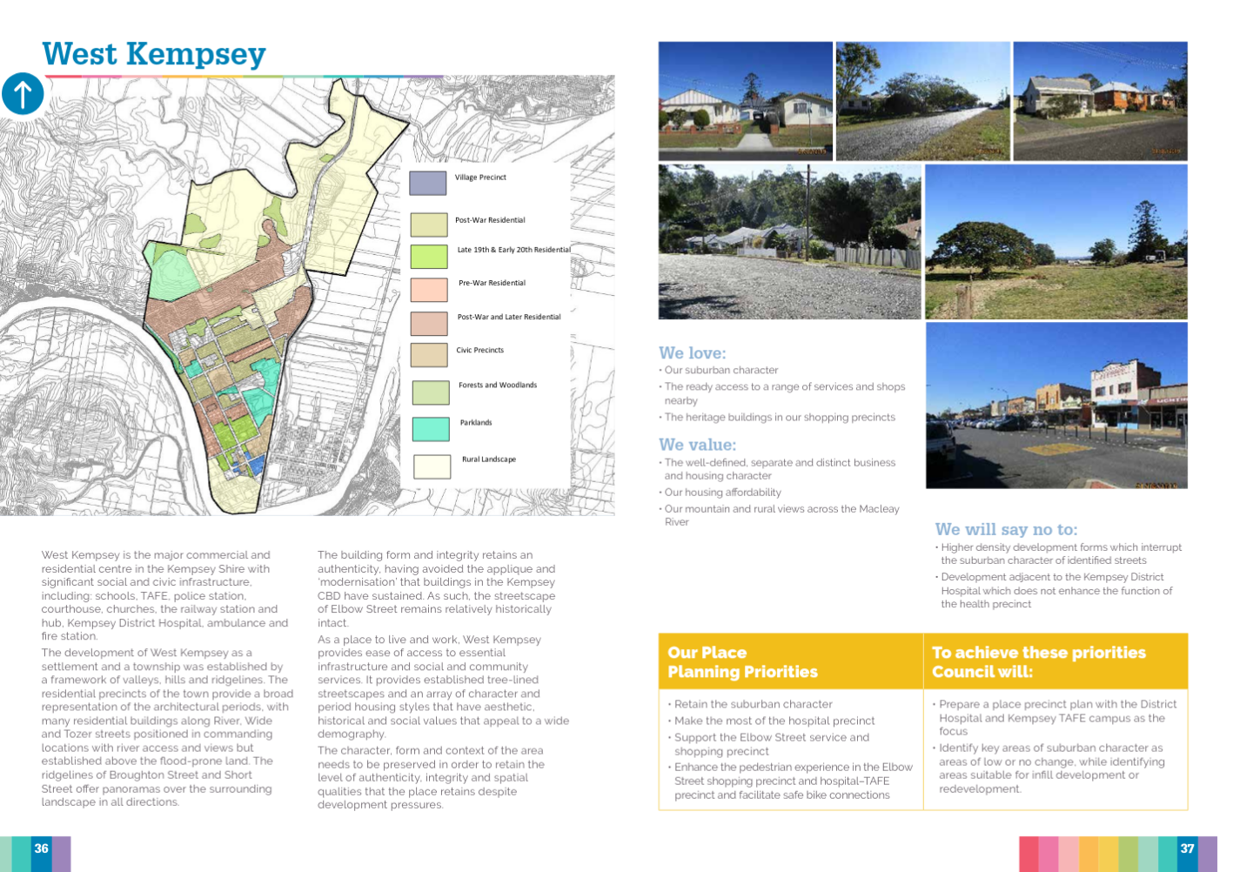

Slide 16
Line of sight – North Coast Regional Plan
Goal 1 – the most stunning environment in NSW
Goal 2 – A thriving, interconnected economy
Goal 3 – Vibrant and engaged communities
Goal 4 – Great housing choice and lifestyle options
Deliver growth that does not compromise the Shire's rich biodiversity
Rehabilitate and enhance biodiversity, coastal and aquatic habitats, and water catchments
Manage natural hazards and climate change

Slide 17
Line of sight – North Coast Regional Plan
Goal 1 – the most stunning environment in NSW
Goal 2 – A thriving, interconnected economy
Goal 3 – Vibrant and engaged communities
Goal 4 – Great housing choice and lifestyle options
Develop successful centres of employment and increase formal education opportunities with the community
Facilitate the growth of tourism
Strengthen regionally significant transport corridors
Facilitate air, rail and public transport infrastructure
Enable resource extraction, protect and enhance productive agricultural lands and grow agribusiness across the Shire

Slide 18
Line of sight – North Coast Regional Plan
Goal 1 – the most stunning environment in NSW
Goal 2 – A thriving, interconnected economy
Goal 3 – Vibrant and engaged communities
Goal 4 – Great housing choice and lifestyle options
Enable the economic self-determination of our local Aboriginal communities
Provide great places to live and work
Develop healthy, safe, socially engaged and well-connected communities
Collaborate and partner with Aboriginal communities
Coordinate local infrastructure delivery
Protect and respect our heritage
Maintain the Shire's distinctive built character

Slide 19
Line of sight – North Coast Regional Plan
Goal 1 – the most stunning environment in NSW
Goal 2 – A thriving, interconnected economy
Goal 3 – Vibrant and engaged communities
Goal 4 – Great housing choice and lifestyle options
Plan for housing demand
Increase housing diversity and choice
Deliver well-planned rural residential housing areas
Deliver more opportunities for affordable housing

Slide 20
Key directions / programs
Growth
South West Rocks continues as focus
Frederickton and Stuarts Point emerging
Environment
Biodiversity Strategy
Coastal programs
Local Growth Management Strategy
Employment land
Housing
Landscape and Character
Integrated transport, accessible and inclusive transport
No significant change
Coastal and rural villages (including Pt Plomer Rd)
Sustainability and resilience
Flood planning

Slide 21
What happens next
Community feedback
Consider submissions and review plan
Council decision to adopt

