Slide 1

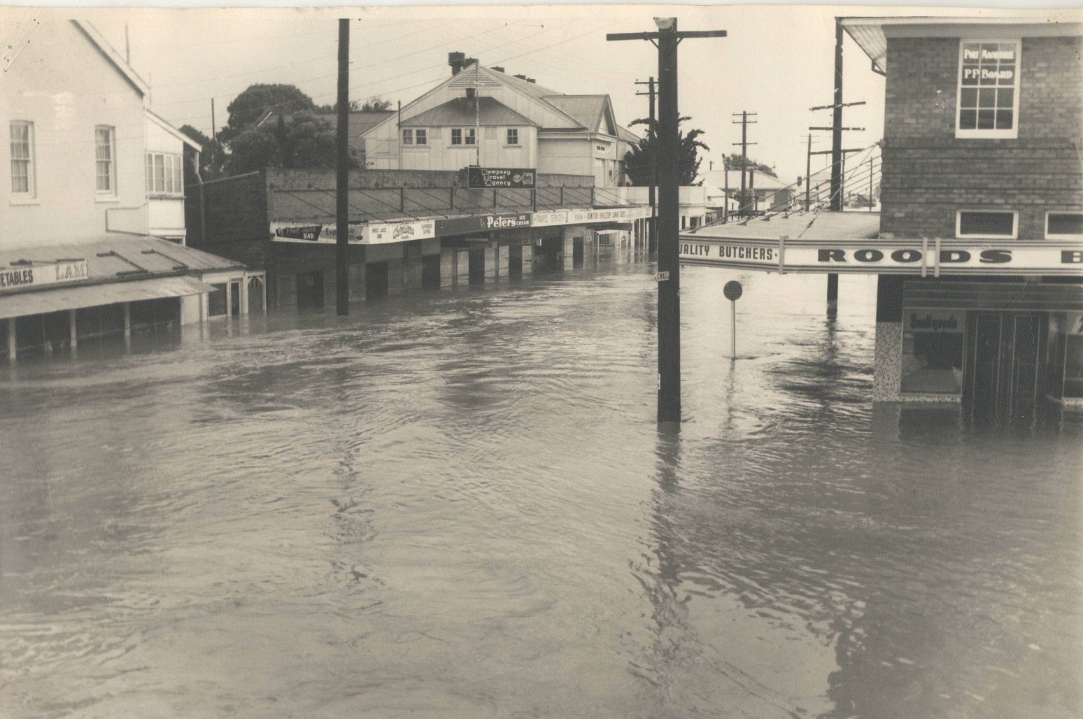
Welcome to KSC’s Information Session
on the
Draft
Kempsey CBD Flood Risk Management Study & Plan
The Draft Kempsey Flood Risk Management Study & Plan has been prepared by specialist flood consultants WMAwater for Kempsey Shire Council with financial assistance from the NSW Flood Management Program

Slide 2
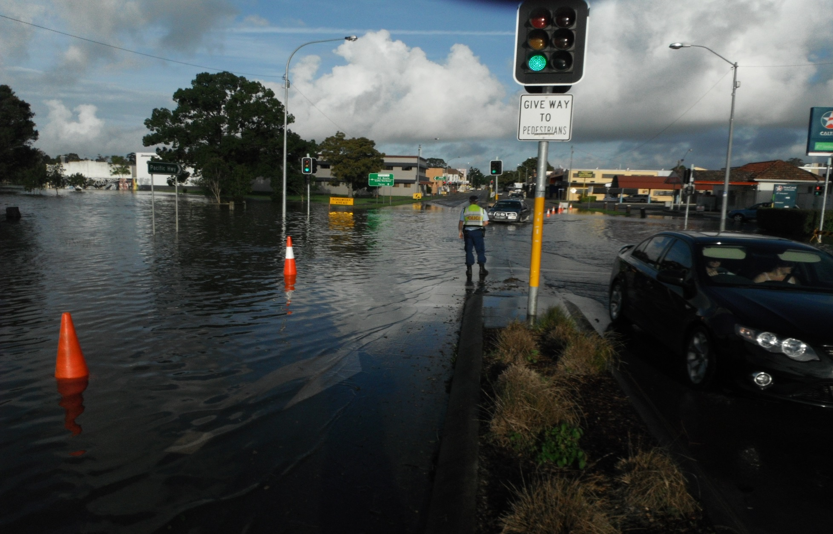
Kempsey CBD Flood Risk Management Study & Plan
This Information Session:
The FRMS&P process (to-date)
The Flood (hydraulic) Study & FRMS outcomes
The FRMP recommendations
Seek feedback & comments

Slide 3
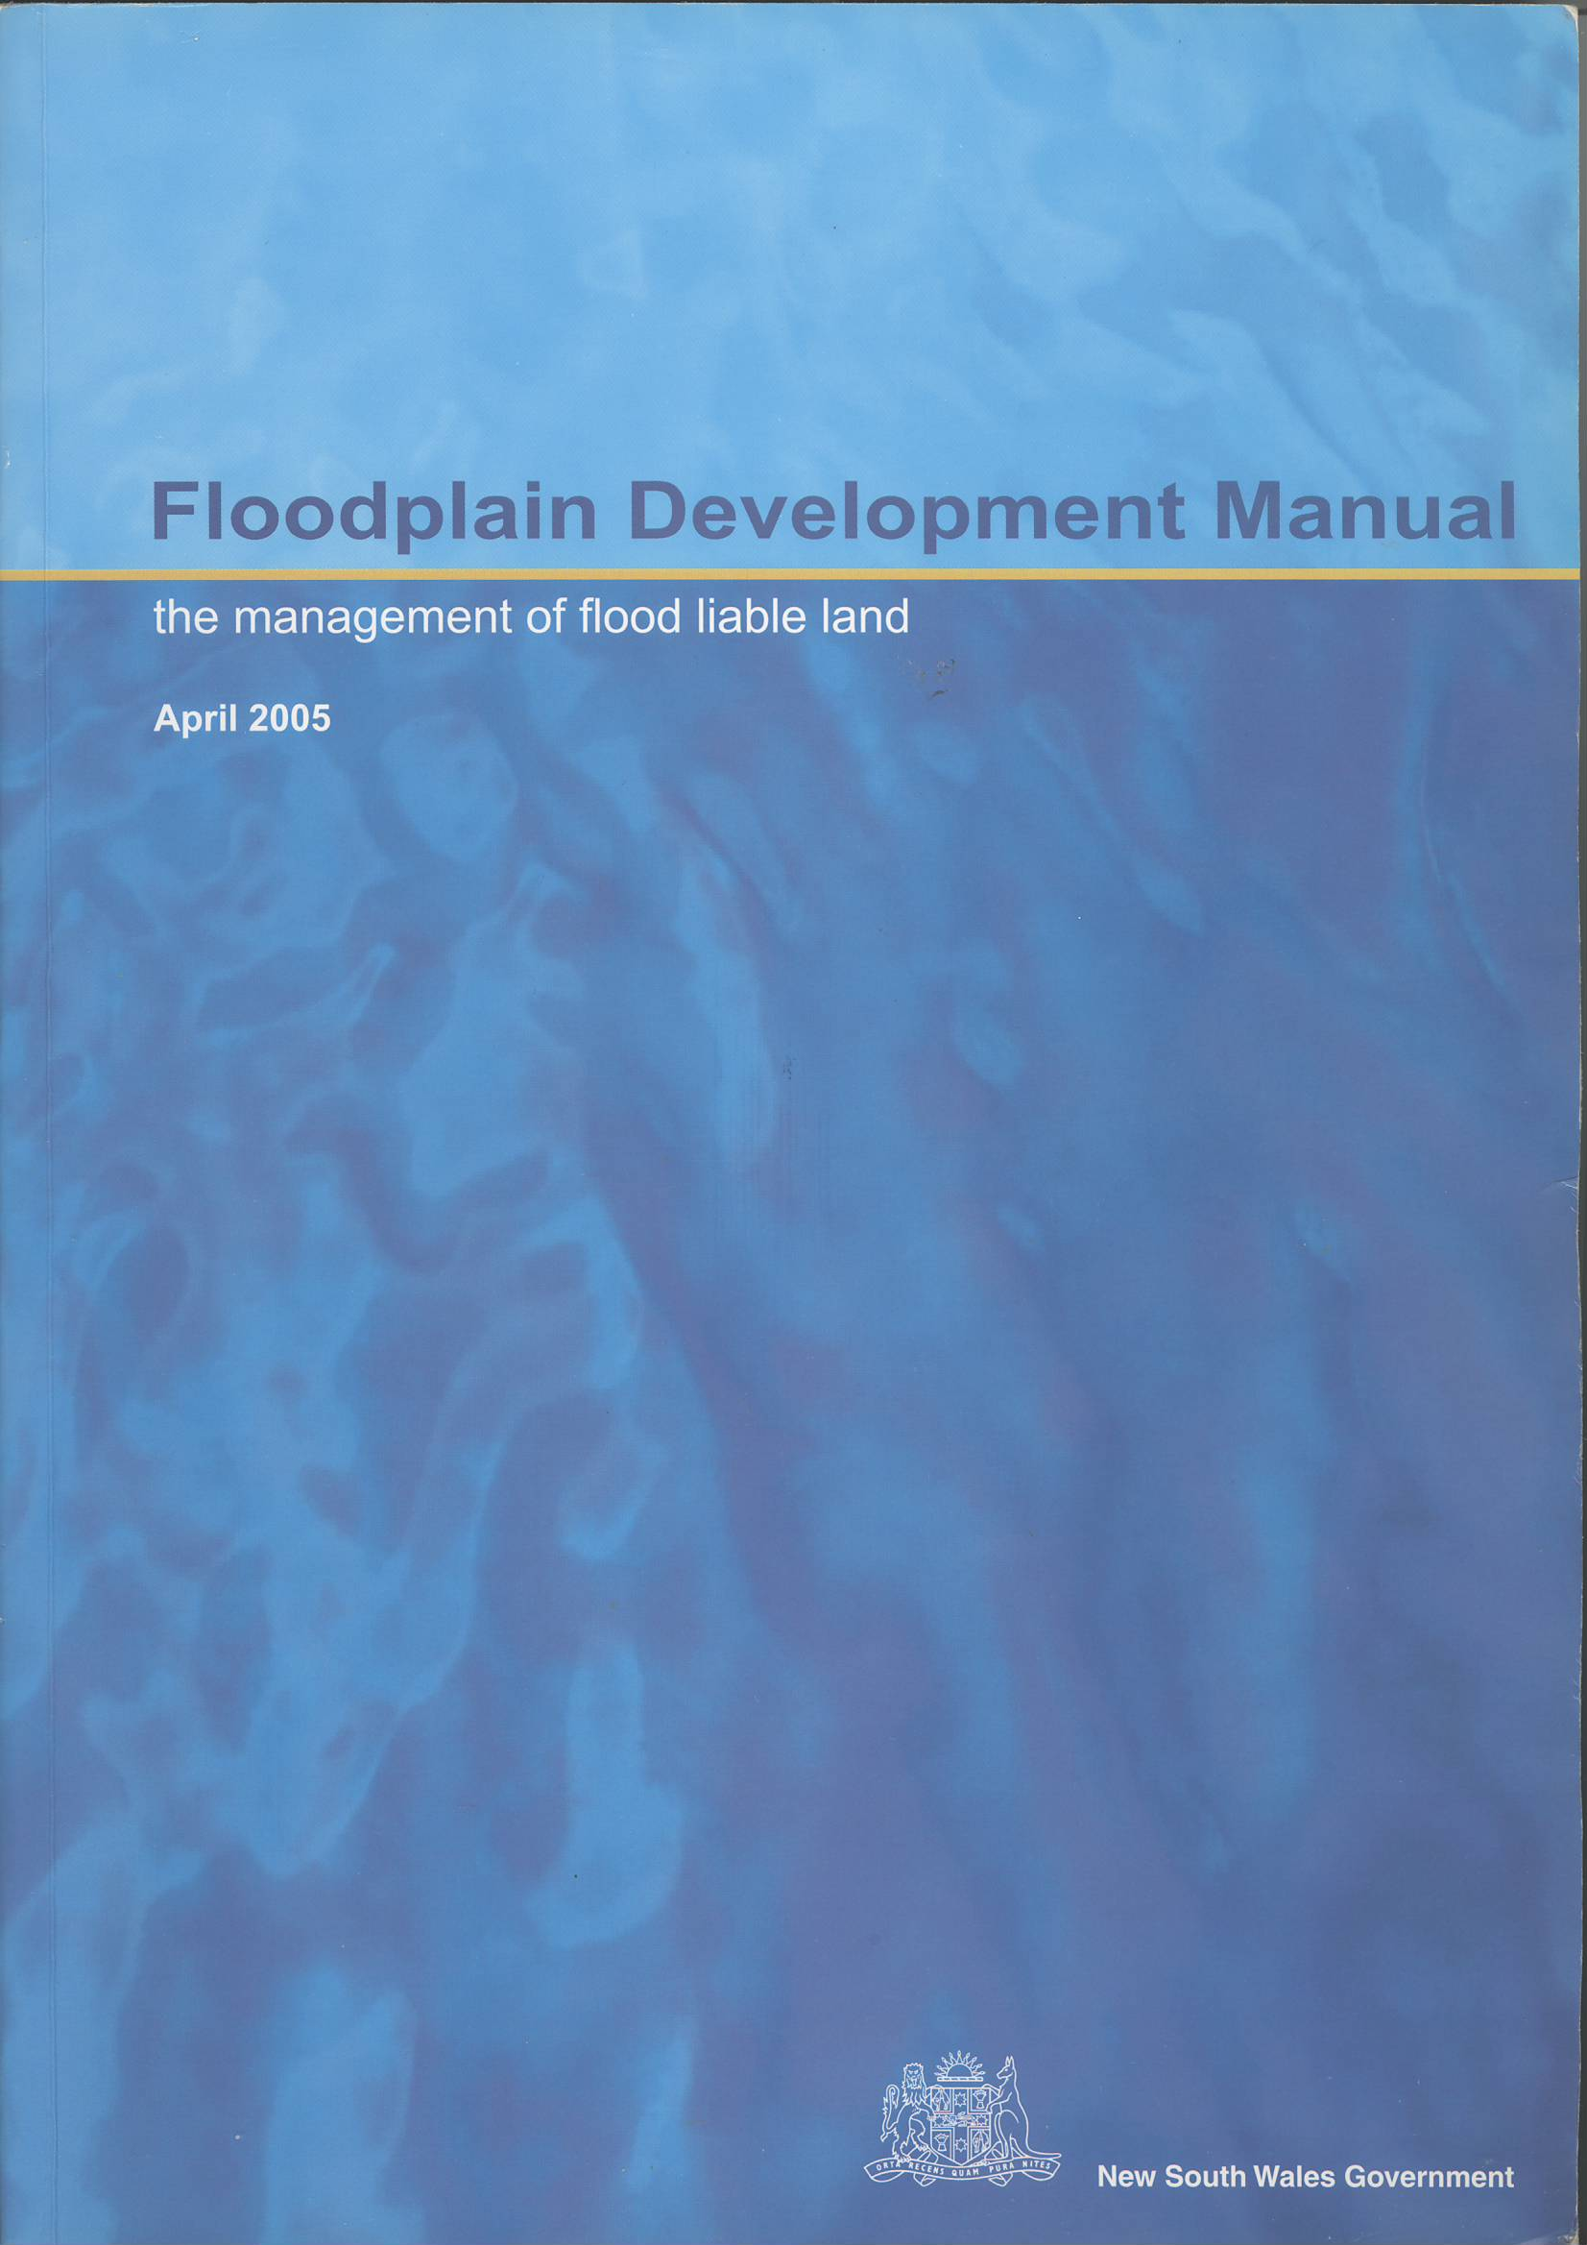
NSW Governments Floodplain Development Manual – sets out procedures to be followed when preparing Flood Risk Management Plans – as follows;
1. Collection of Data • Compiling existing historical and new information.
2. Flood Hydraulic Study • Determine the nature and extent of the flood problem.
3. Floodplain Risk Management Study (FRMS) • Evaluates management options, having regard for social, ecological, economic factors
which relate to flood risk.
4. Floodplain Risk Management Plan (FRMP) • A Management Plan provides input into the strategic and statutory planning roles of councils, and is the formalisation of effective flood risk management processes.
5. Implementation of the Plan • Construction of flood mitigation works, use of Local Environmental Plans to ensure new development is compatible with the flood hazard etc.
6. Review of the Implemented Plan • To account for changes in the issues originally addressed and consider any emergent issues since the plan was first implemented. This is an ongoing process which should be undertaken on a regular basis such as every 5 years and when significant changes occur which could affect the plan as well as when further information become available such as after significant flood events.
To be eligible for funding Councils have to demonstrate that they can and have followed the flood risk management process outlined in the Floodplain Development Manual.

Slide 4
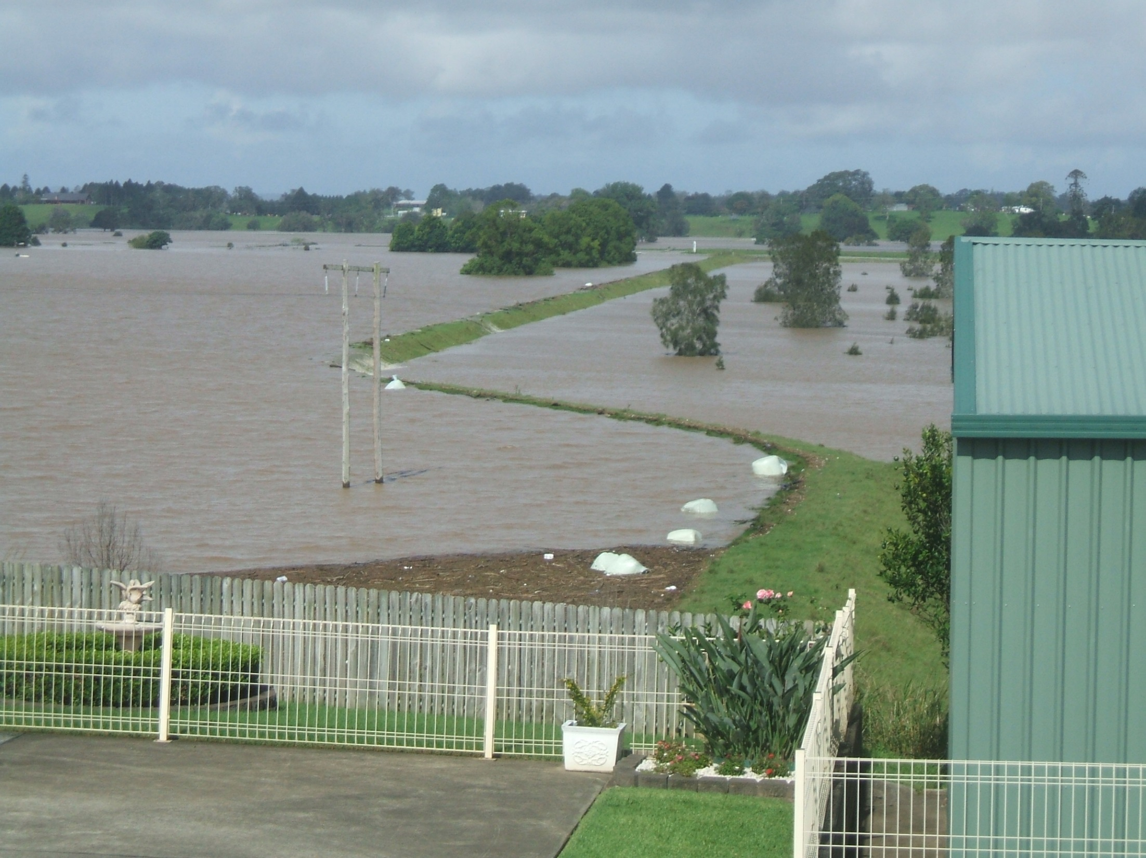
This information Session to provide an overview on Stages 2,3 & 4

Slide 5
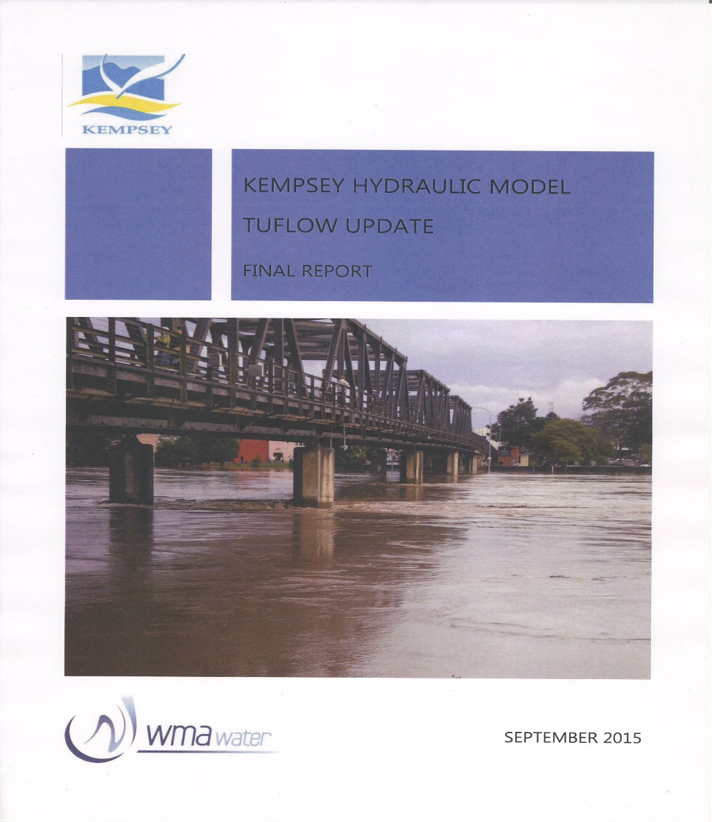
Stage 2: Flood Study (Hydraulic modelling)
A flood study is a technical investigation of flood behaviour.
Constitutes the major technical foundation for floodplain risk management plans (Stage 4)
The TUFLOW model is considered more appropriate because its ability to easily model possible management options.
A TUFLOW model was developed for the Pacific Hwy upgrade and updated for use in the Kemspey CBD Flood Risk Management Study & Plan
Incorporated detail LiDAR Survey.
Can better define spatial variations in flood behaviour such as flow velocity, flood levels & hydraulic hazards
Previous Kempsey hydraulic study/modelling:
(1997) RUBICON (1D)
(2009) SOBEK (quasi-2D)
For the 2015 study the SOBEK model was converted to TUFLOW 2D model
Model calibration – using comparison of model results with March 2001 flood observations – verification using Feb 2013 event which occurred during the study

Slide 6
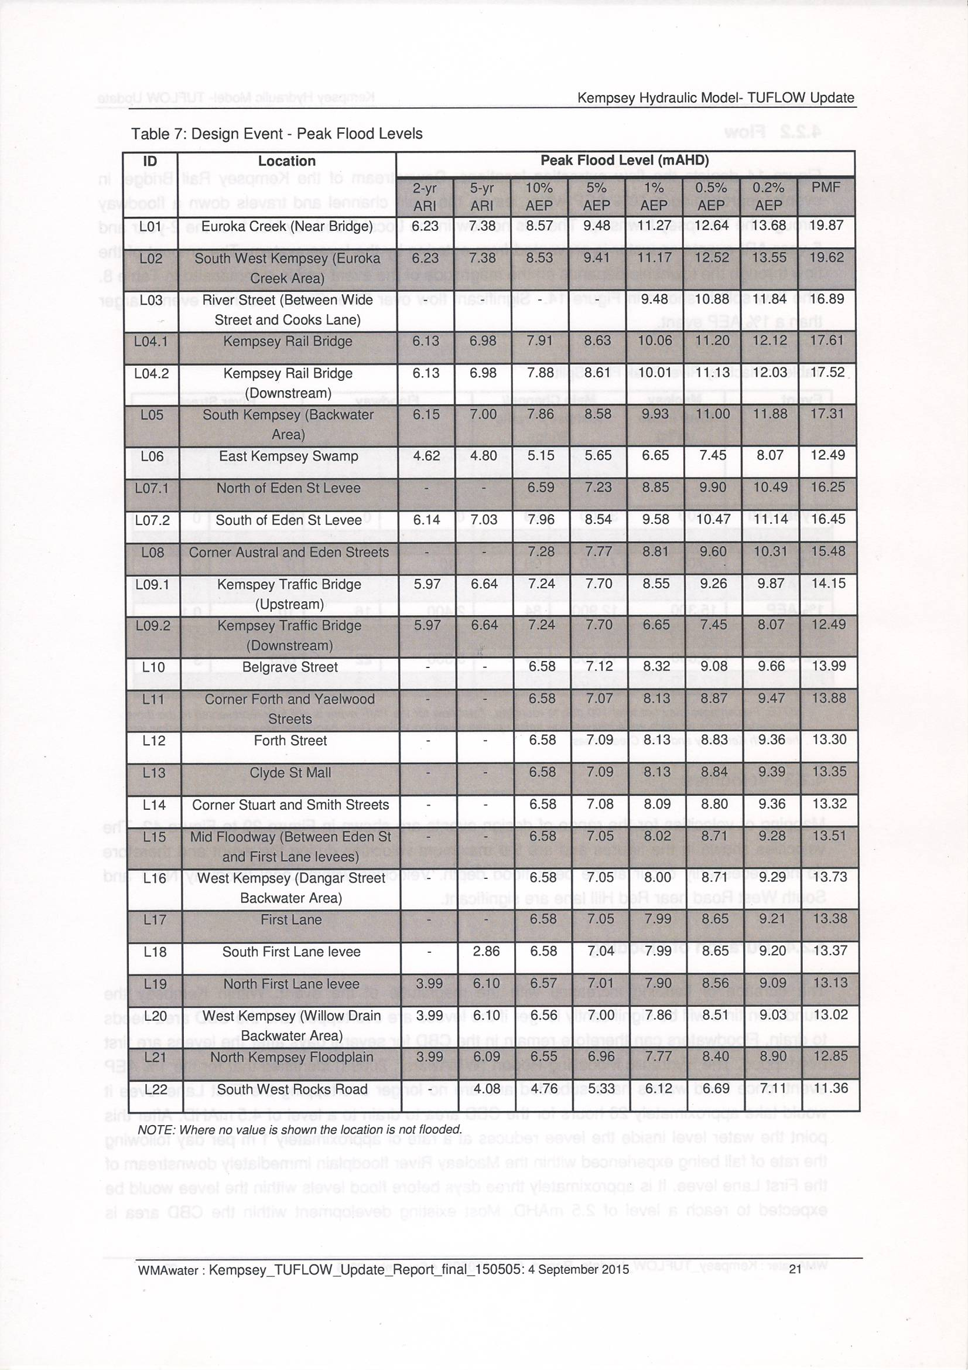
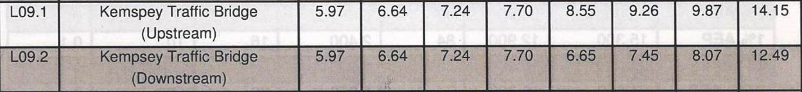
m = mAHD (mean/average sea level = 0.000mAHD)
Major Kempsey Flood Events
WL @ KTB:
Aug 1949 = 8.40m=90y ARI
Jun 1950 = 80y ARI
May 1963 =7.62m =~20yARI
Flood event modelling included;
2 & 5year ARI
10%, 5%, 1%, 0.5%, 0.2% AEP &
PMF
Assessment of modelled flood levels, depths & flows
ARI = Average Recurrence Interval
The long term average number of years between the occurrence of a flood as big or larger than the selected event.
For example: floods with a discharge or height as great as or greater than the 20 year ARI design flood event will occur on average once every 20 years (i.e. the likelihood of occurrence of a flood event)
AEP = Annual Exceedence Probability
The chance of a flood of a given or larger size occurring in any one year – expresses as a %
For example: if a peak flood discharges or height has an AEP of 5%, it means that there is a 5% chance (i.e. a 1 in 20 chance) of a peak (or larger) occurring in any one year.
Recent Macleay events:
Mar 2001= 7.50m = 13yARI
May 2009 = 7.23m = 9yARI
Jun 2011 = 7.08m = 5yARI
Feb 2013 = 7.12m = 7yARI
Town Levee design heights
Eden St 7.5m (7.30 to 7.70)
RSL 7.26m (7.10-7.15)
First Lane 5.9m (5.86-6.00)
Kempsey CBD levee designed for protection up to a 10% AEP

Slide 7
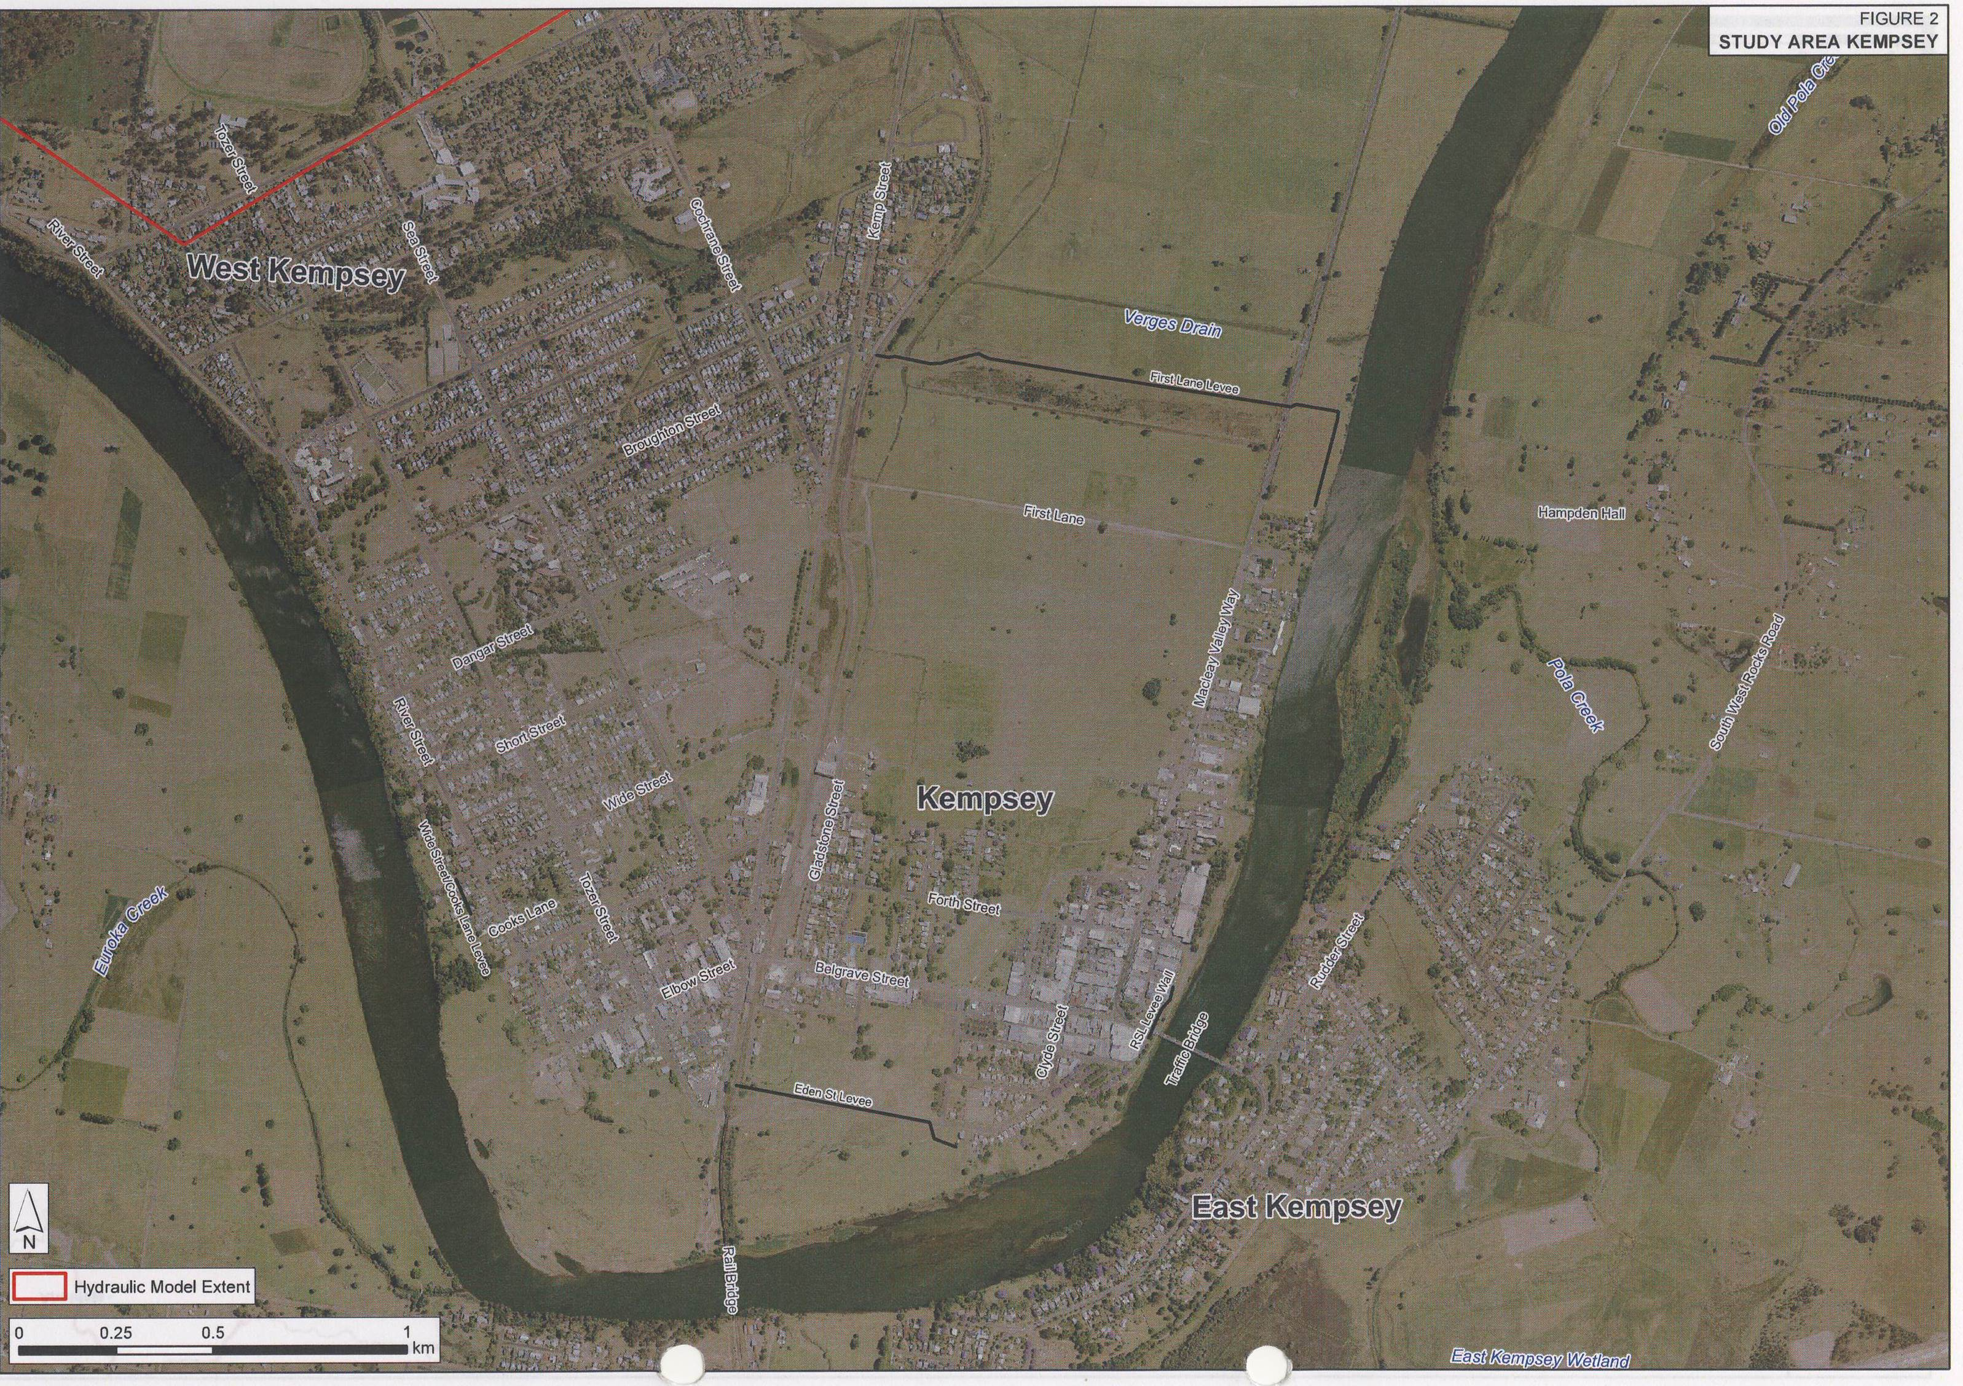
CBD Levees

Slide 8
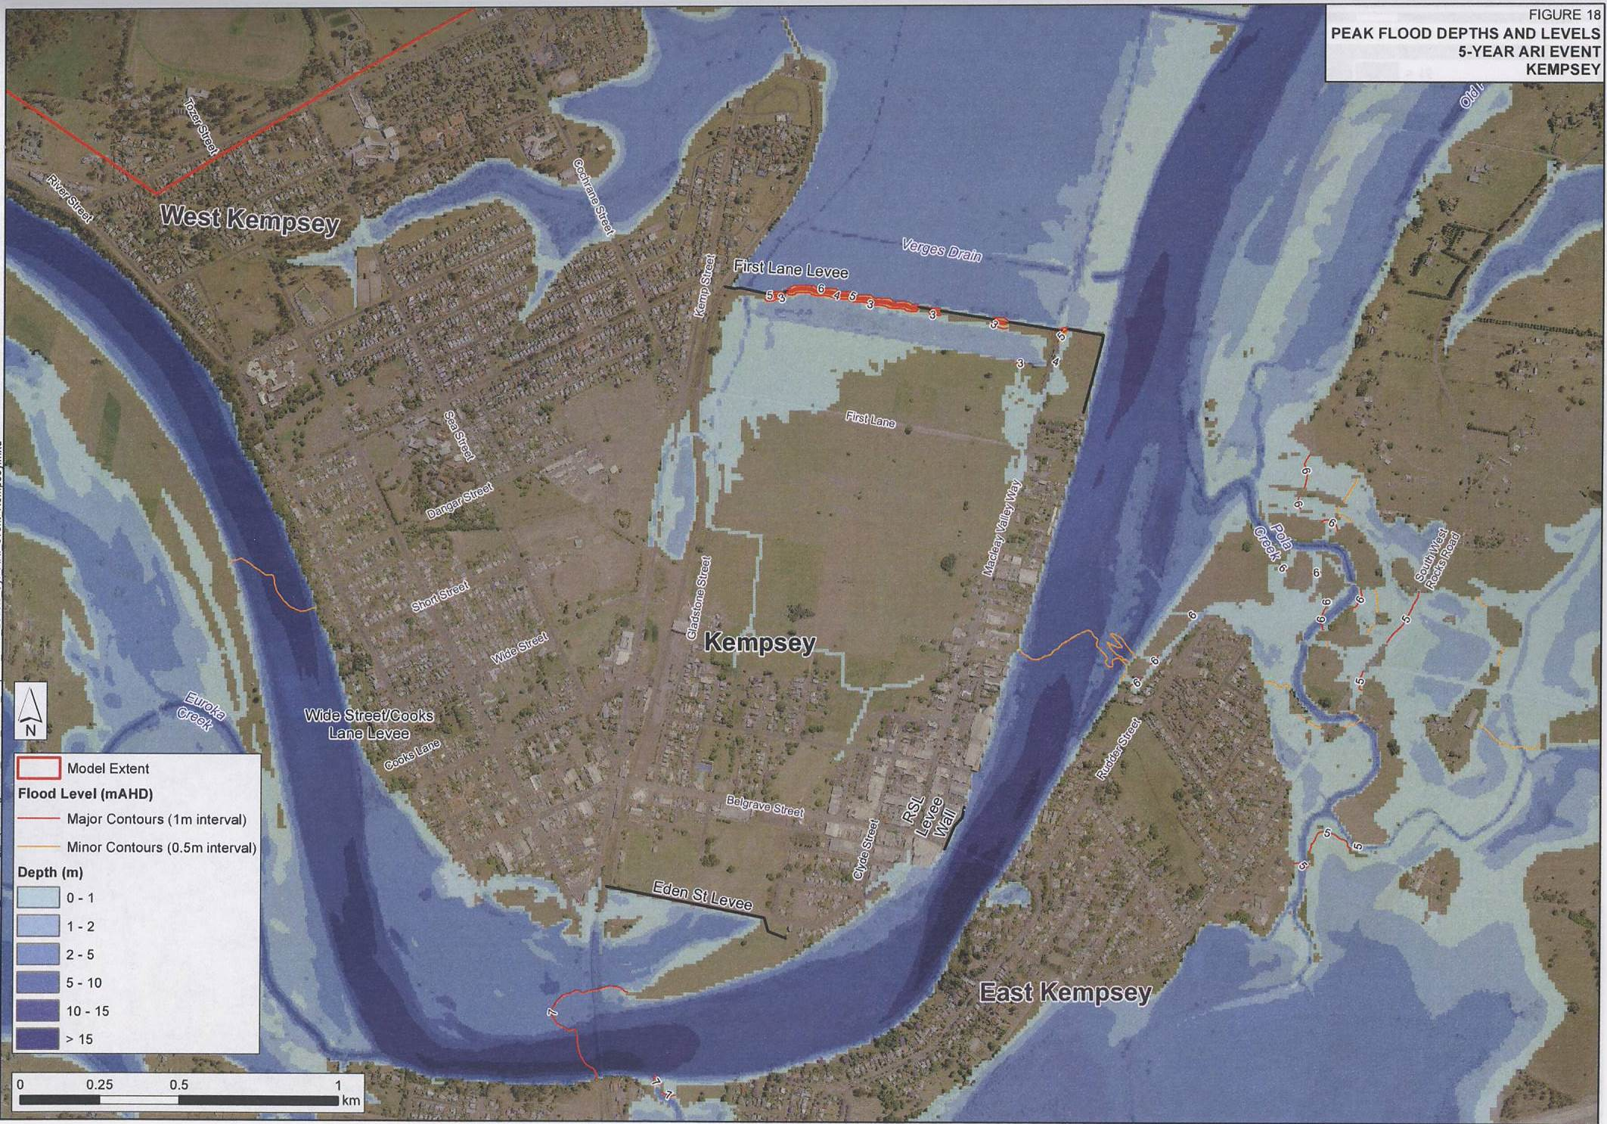
Model output – depths & water levels

Slide 9
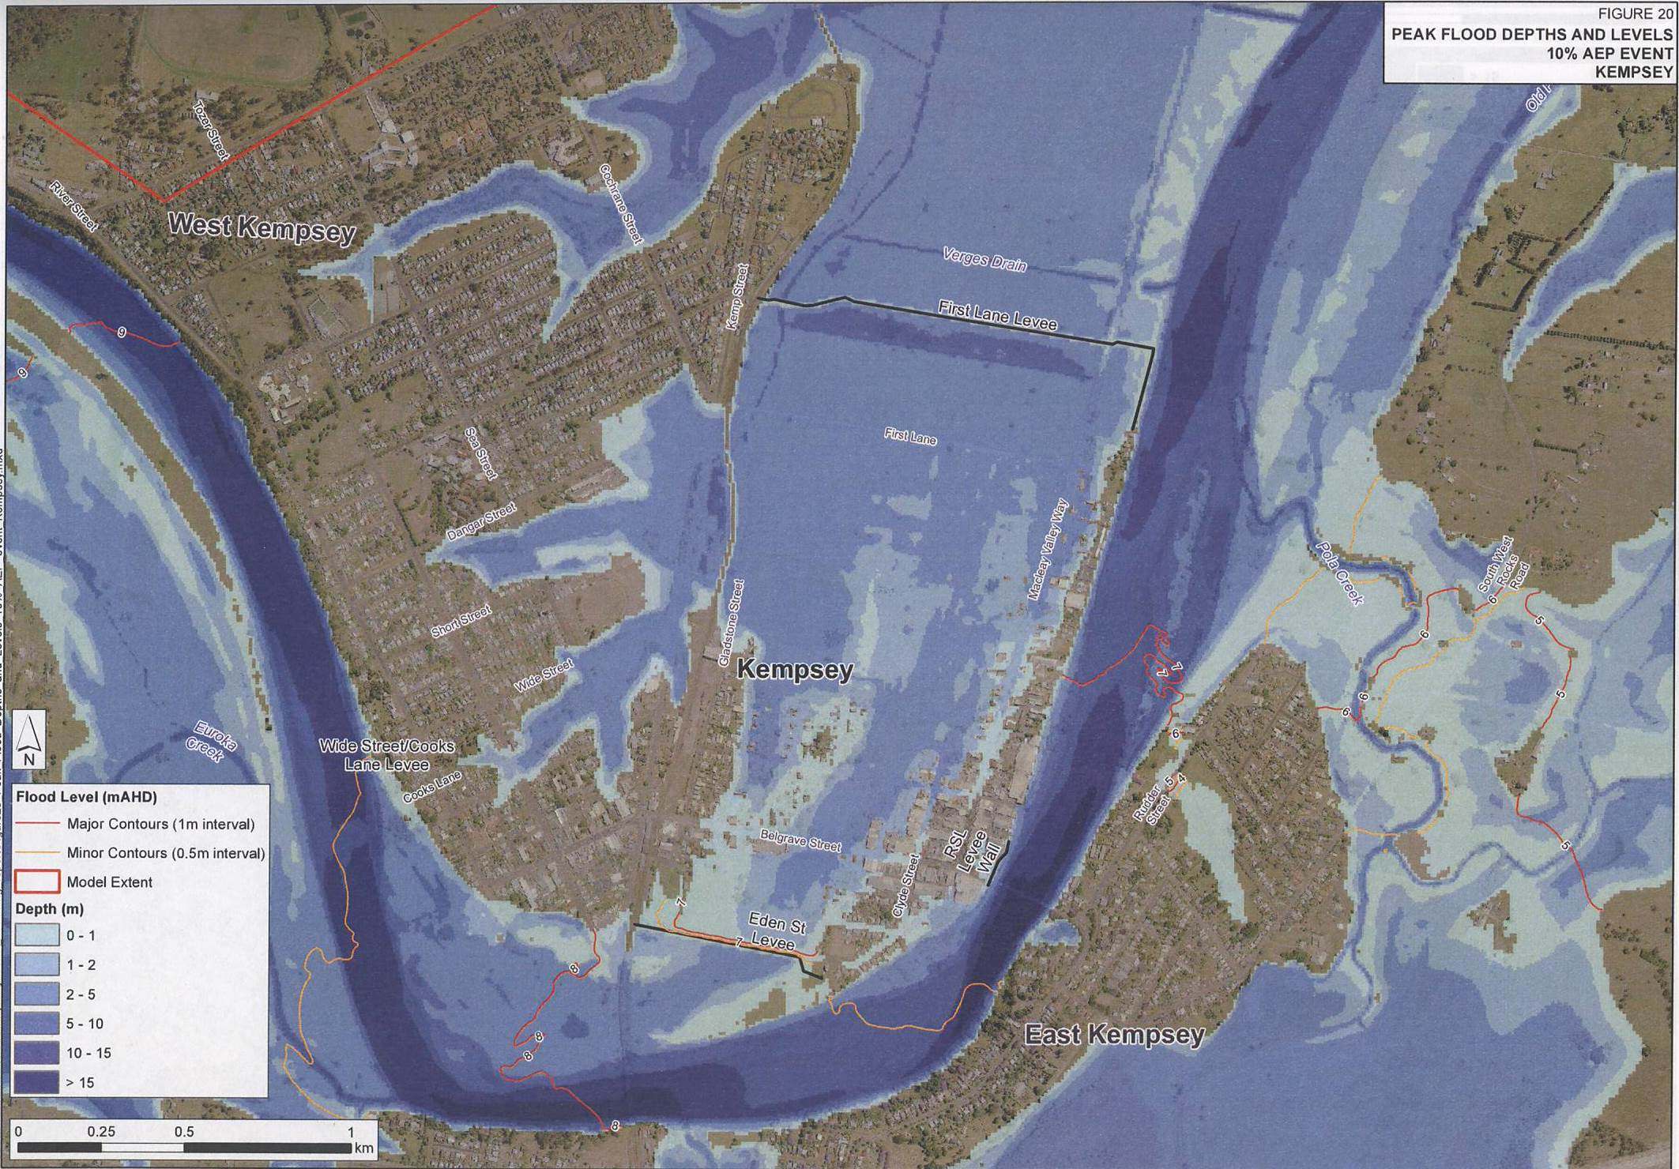
Model output – depths & water levels

Slide 10
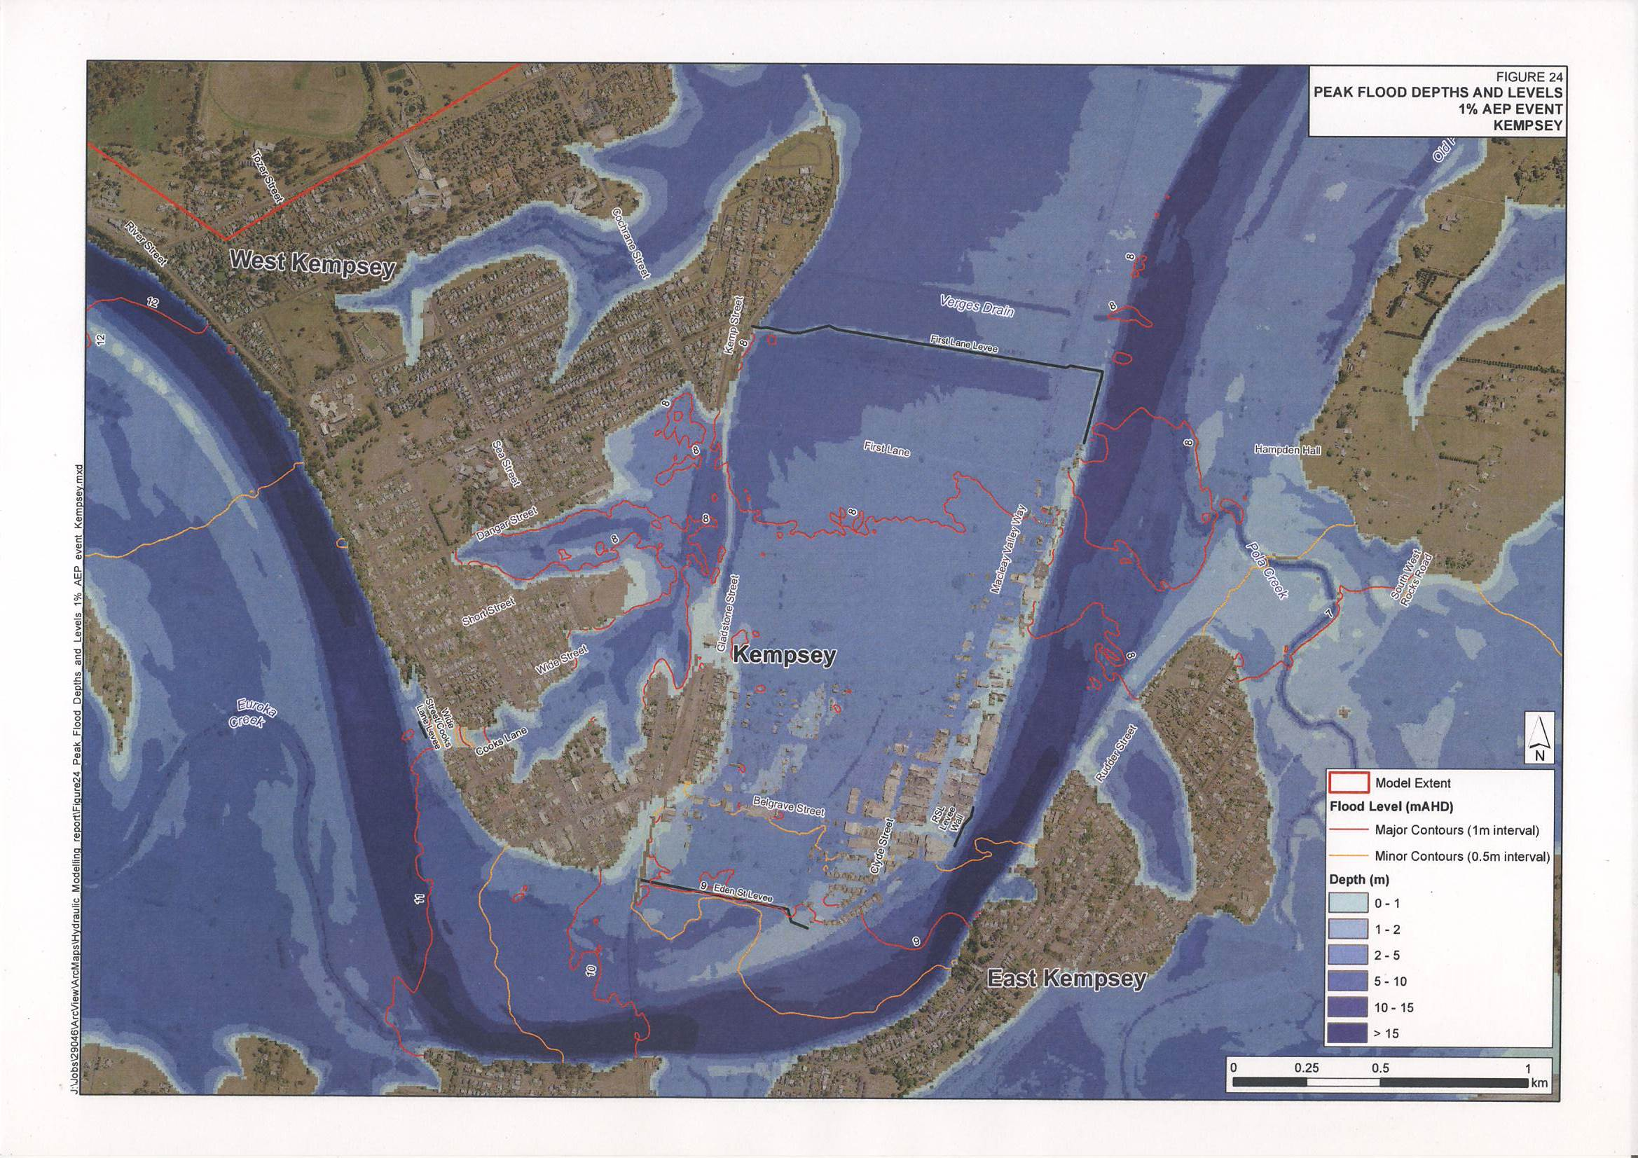
Model output – depths & water levels

Slide 11
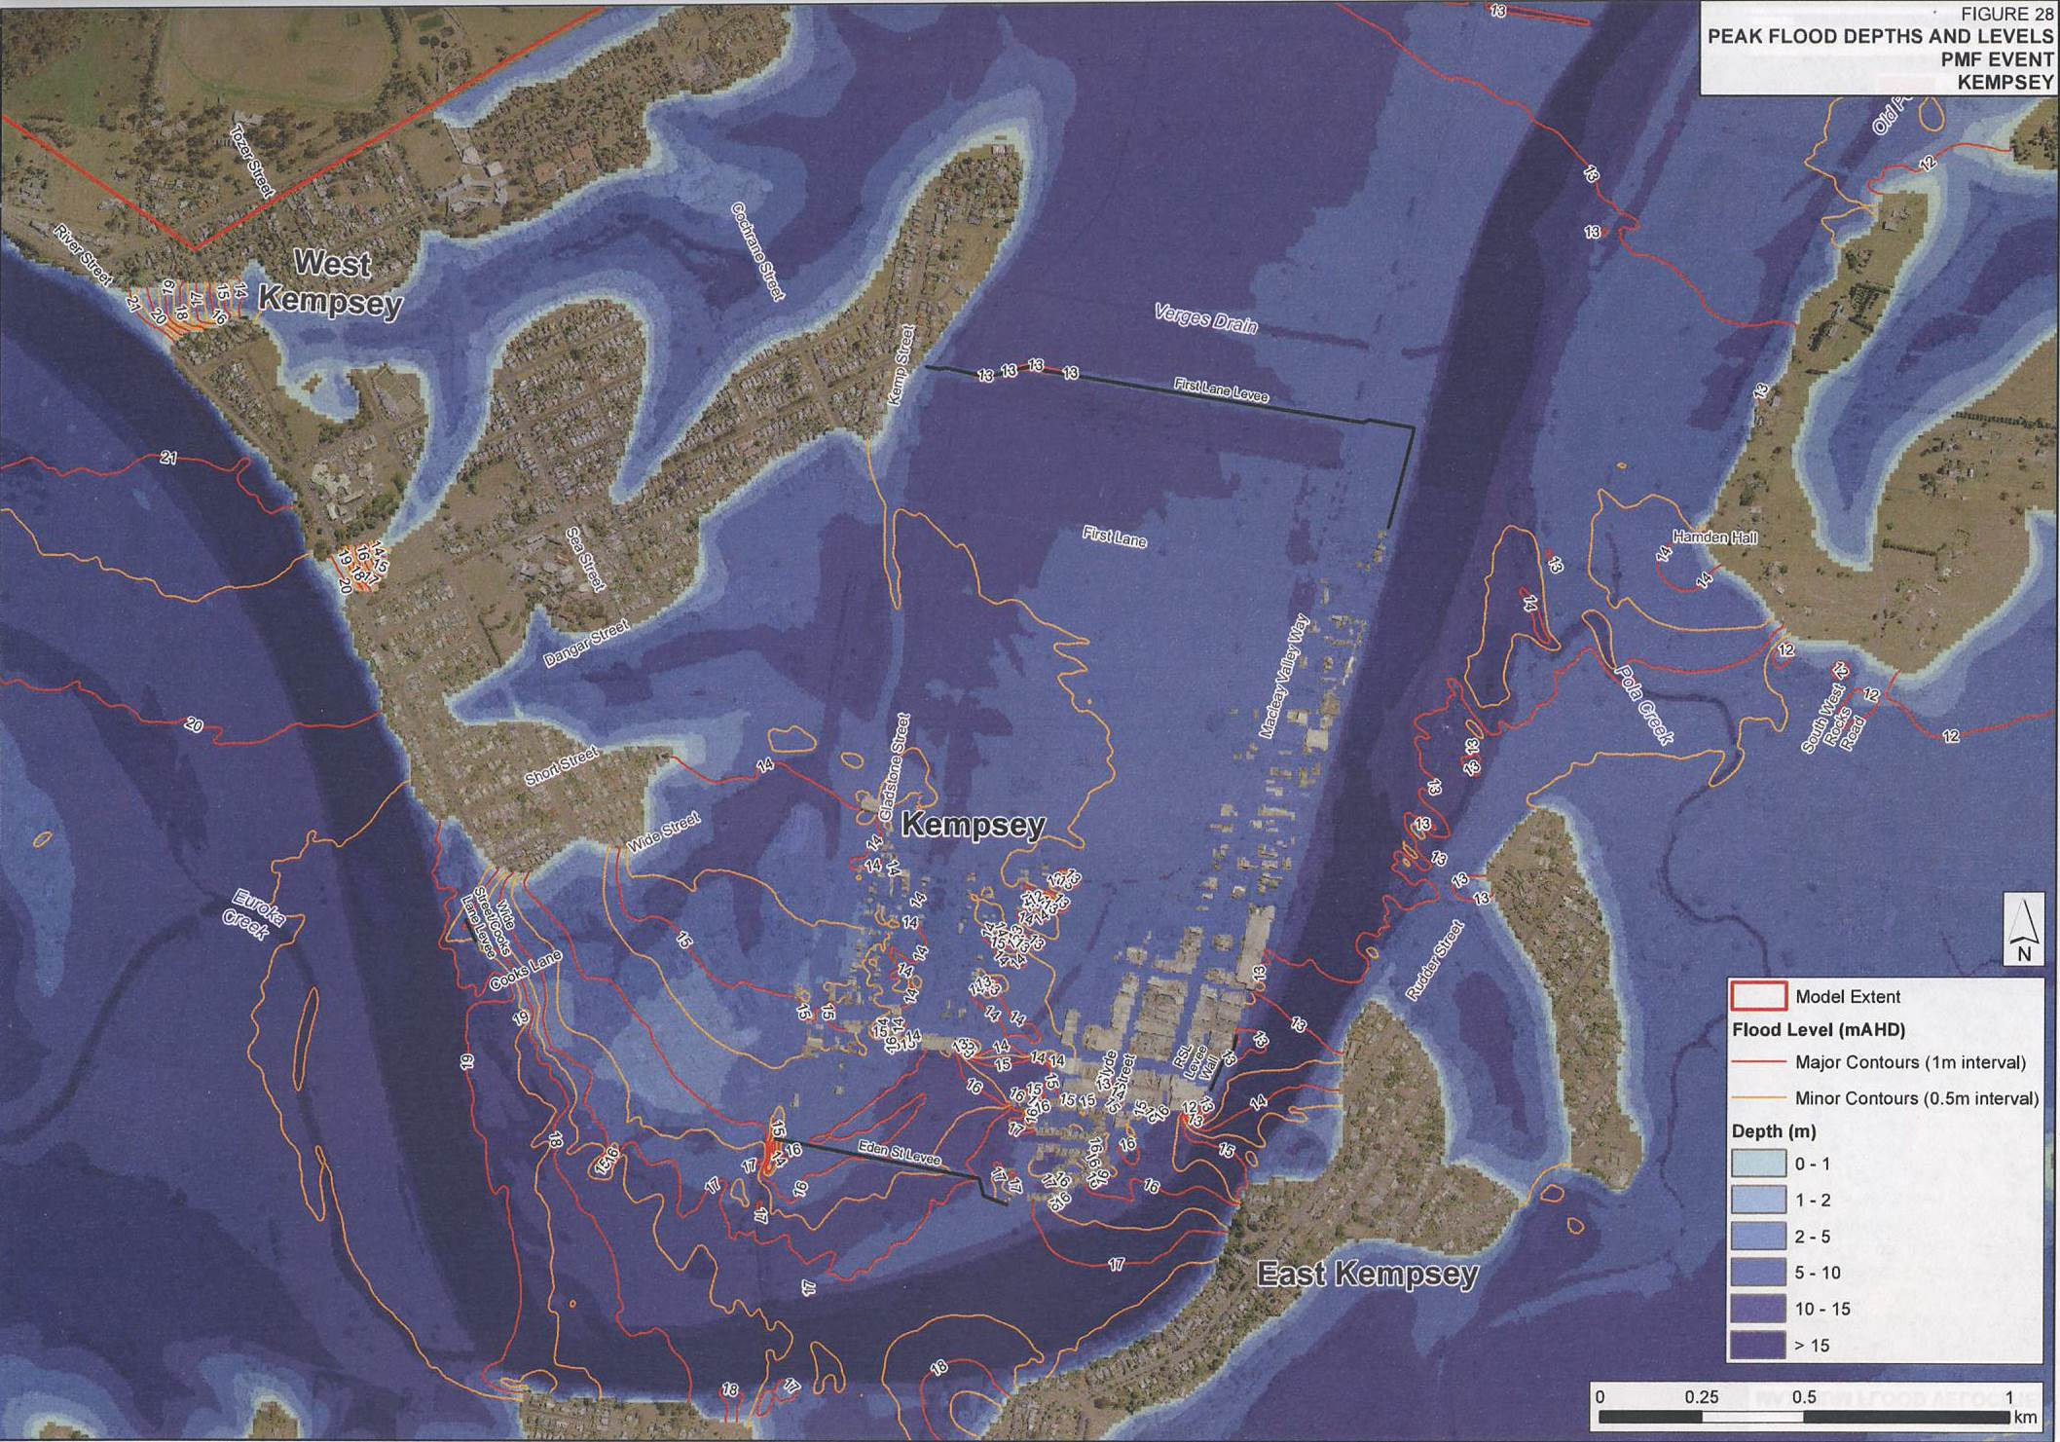
Model output – depths & water levels
The PMF is the largest flood that could conceivably occur at a particular location, usually estimated from probable maximum precipitation, coupled with the worst flood producing catchment conditions.

Slide 12
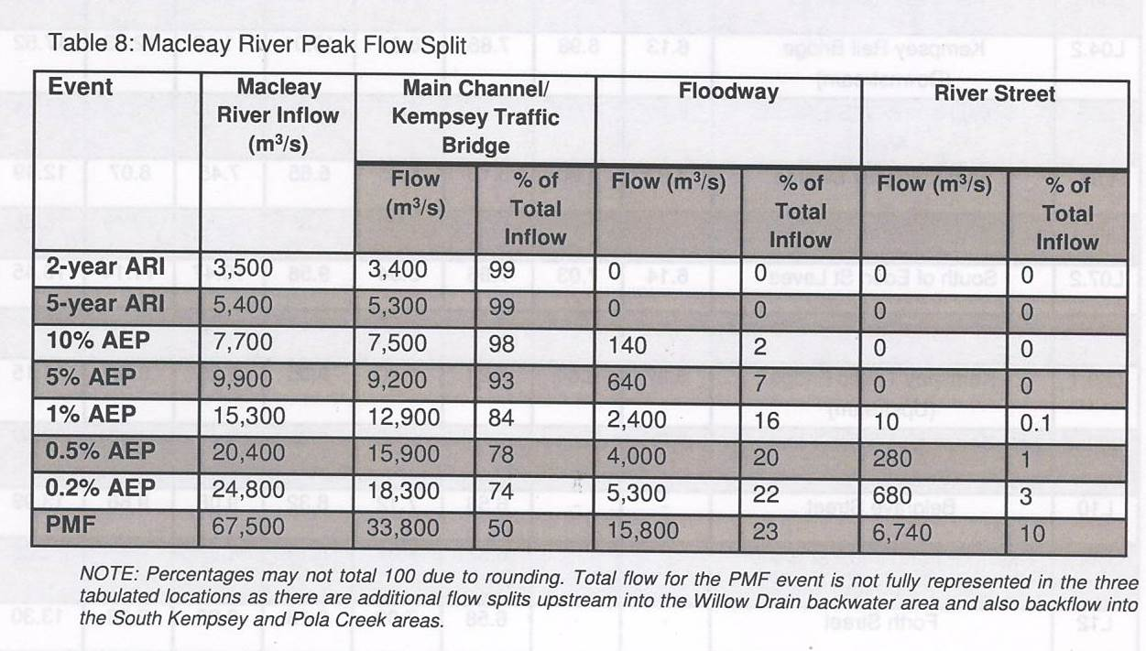
Model output – flood flow information (volume)
1%AEP @15,300m3/s = 918,000m3/minute
Discharge capacity (bankfull):
Belmore Flood Structure = ~560m3/s
Kinchela Flood Structures = ~140m3/s
The velocities shown are the maximum velocities during the event and therefore do not necessarily occur at the peak flood depth.

Slide 13
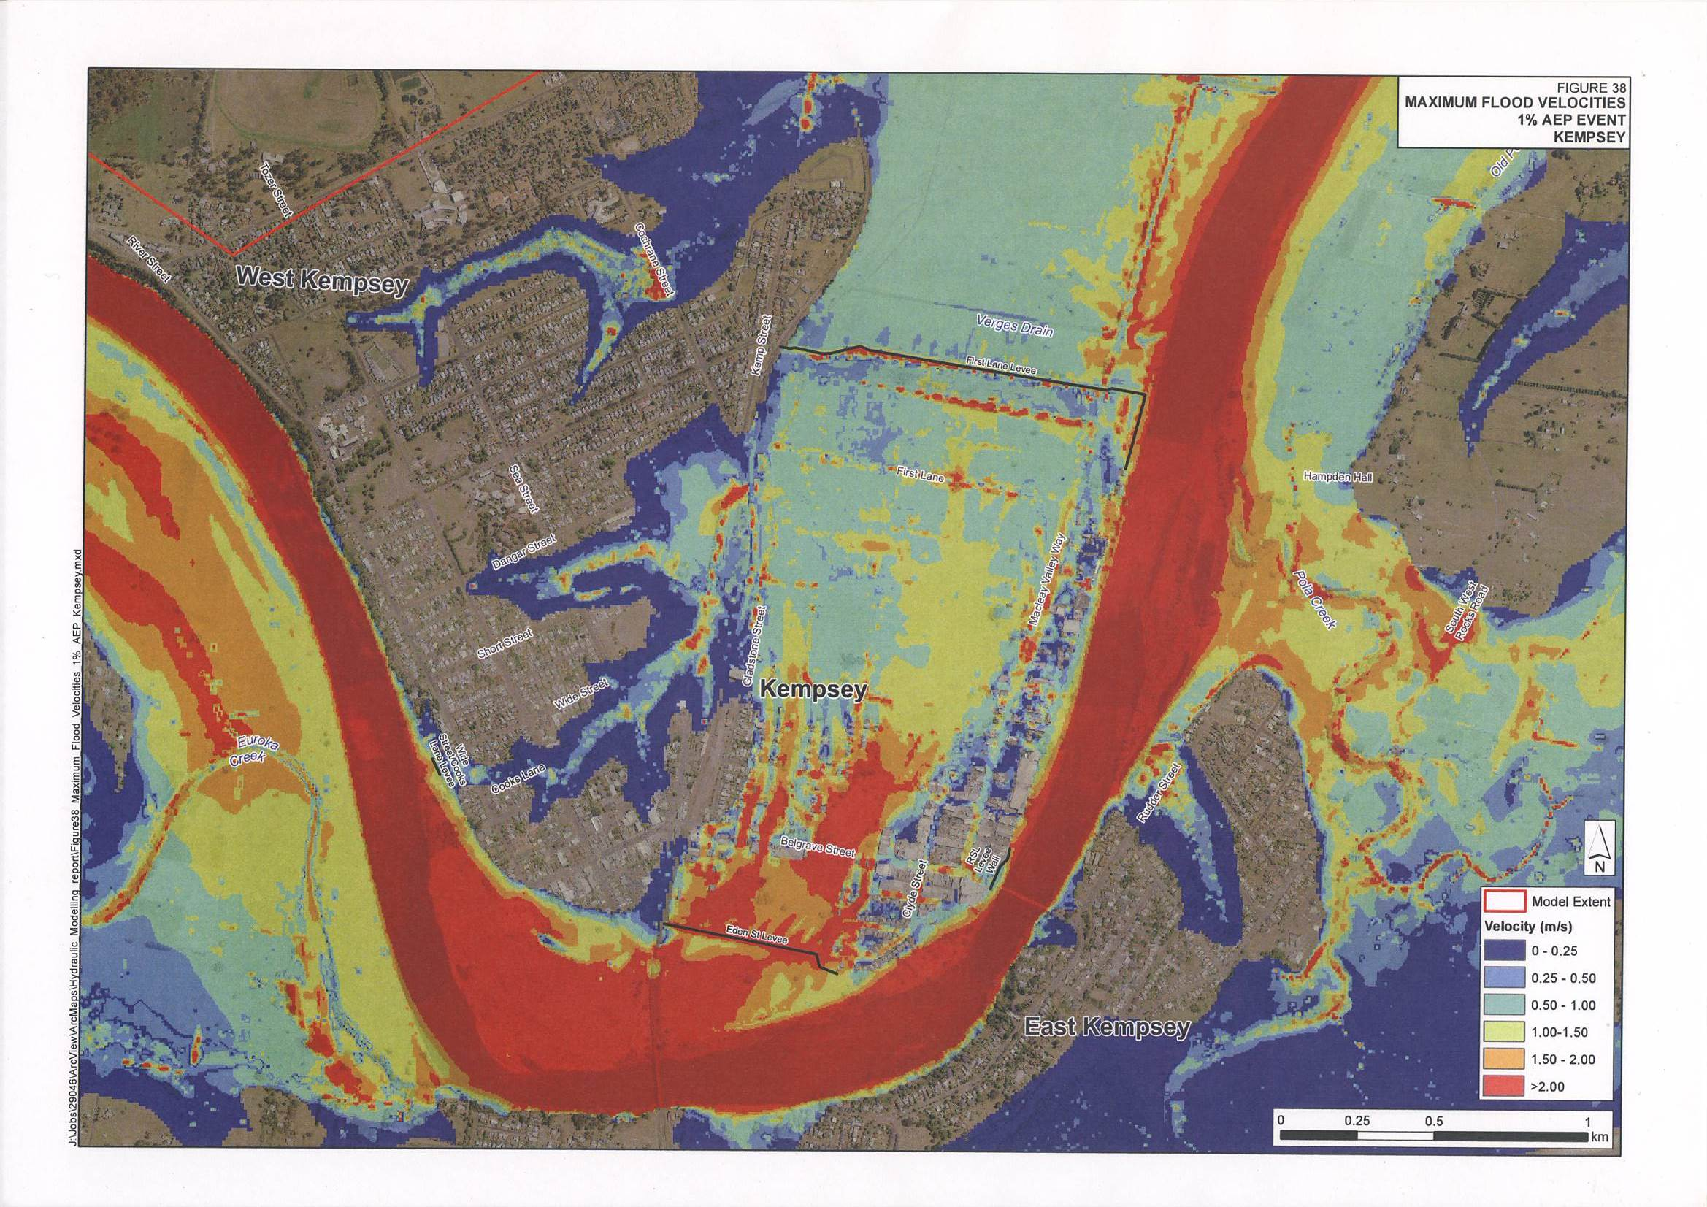
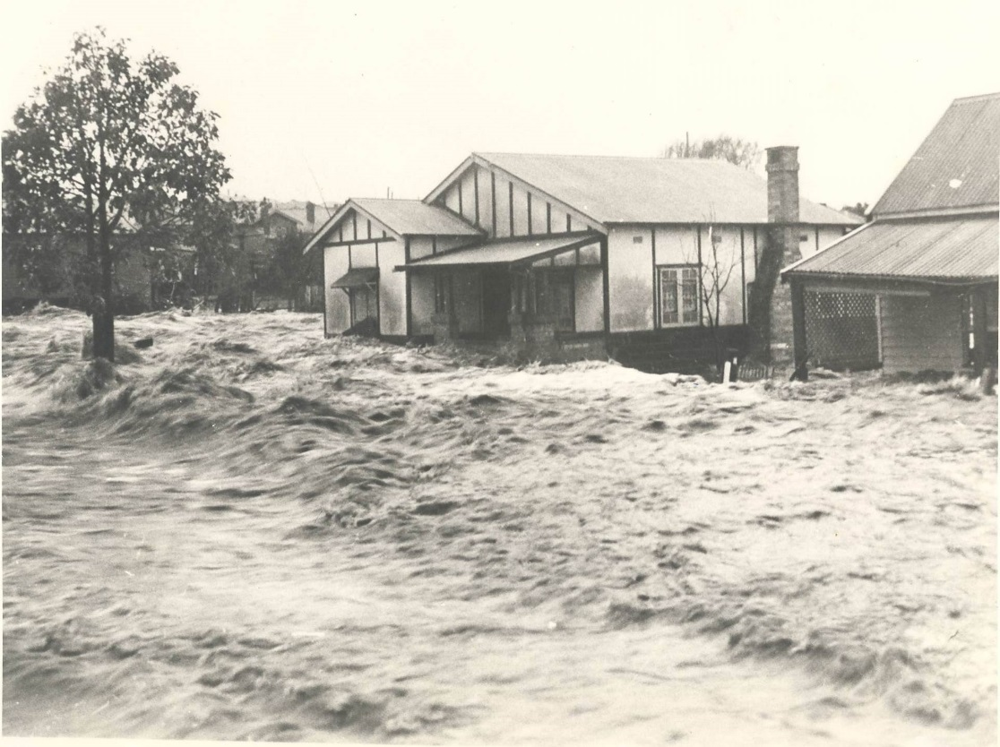
Model output – flood flow information (velocity)

Slide 14
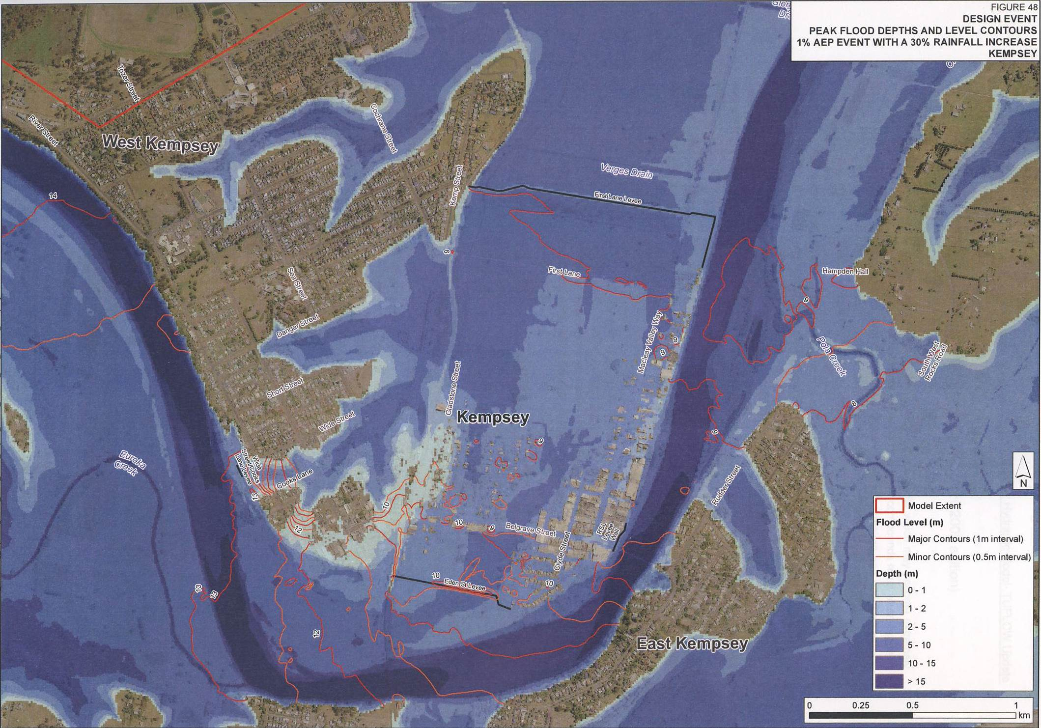
Model output – depth & water levels modelled with possible future climate considerations

Slide 15
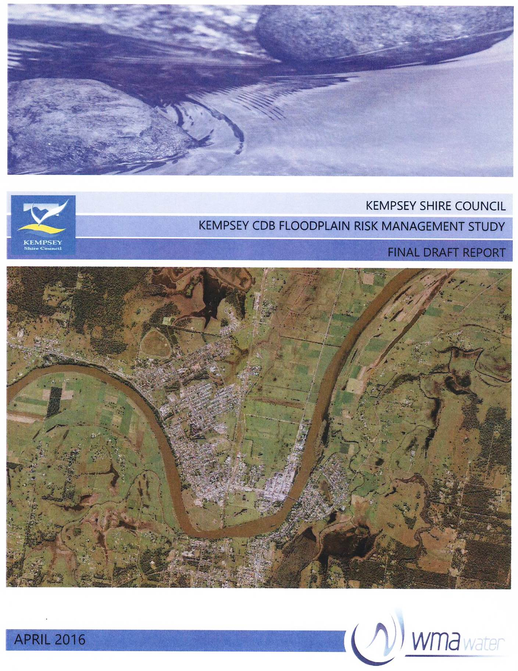
Stage 3: Risk Management Study (FRMS)
A RFMS is a multidisciplinary process that considers a number of differing factors to generate recommendations to deal with different types of flood risk, evaluating management options in respect to existing and proposed development:
FRMS considers;
• Flood behaviour, danger & damage
• Existing & future land use patterns
• Community flood costs
• Flood risk measures and strategies
• Environmental needs, and
• Environment & cultural impacts of proposed/recommended flood risk management measures

Slide 16
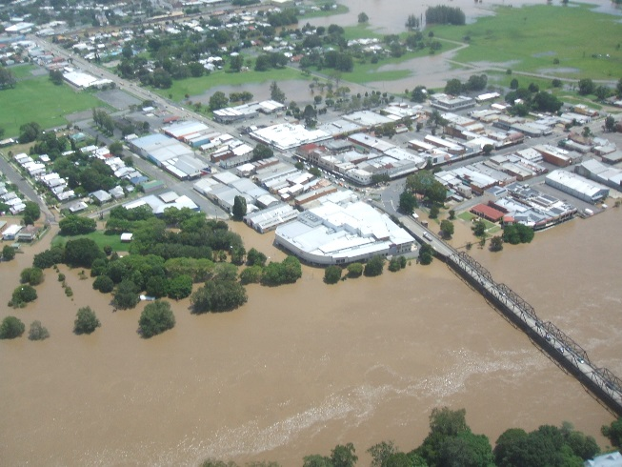
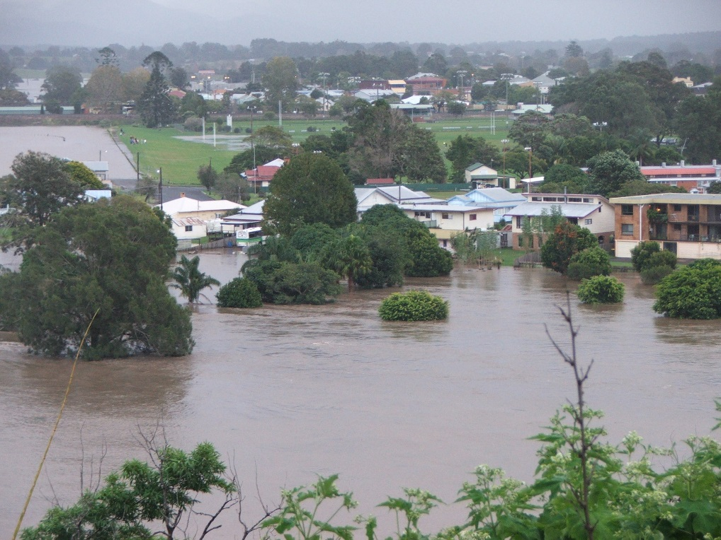
FRMS aim to identify all relevant issues, quantify them and weigh them appropriately into an overall flood risk management Plan, by;
1)drawing together the results of the data compilation study (Stage 1) and the findings of the hydraulic study (Stage 2), and
2) evaluating flood risk management options in respect of both existing and proposed development having regard for social, ecological, economic factors which relate to flood risk.

Slide 17
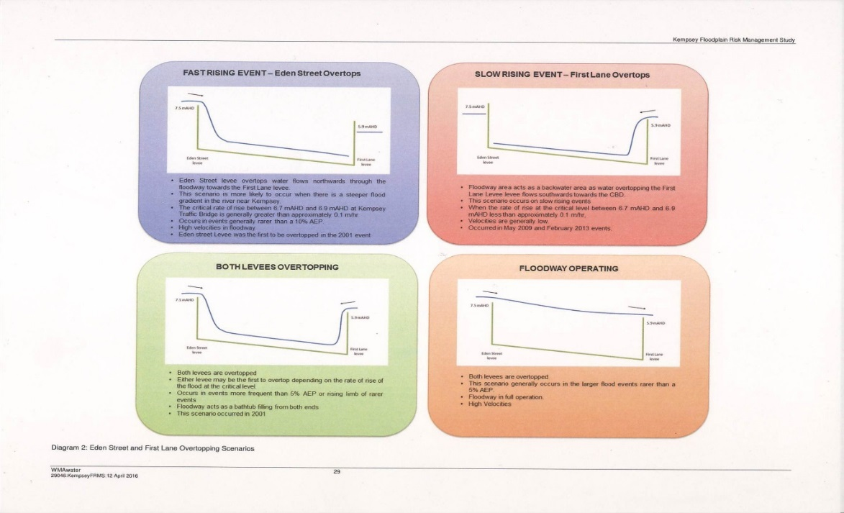
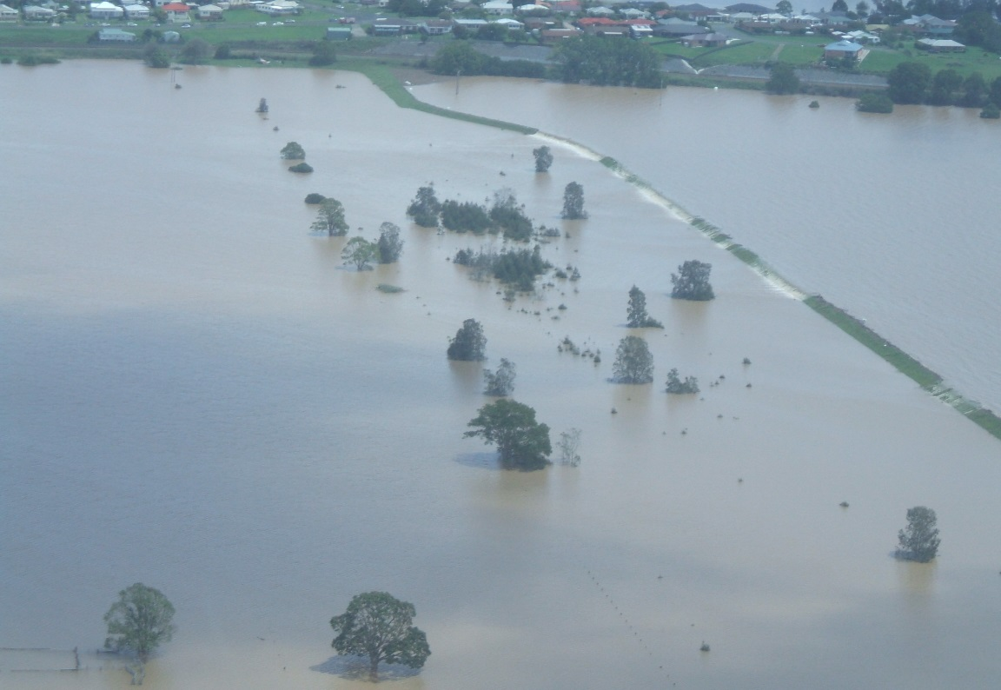
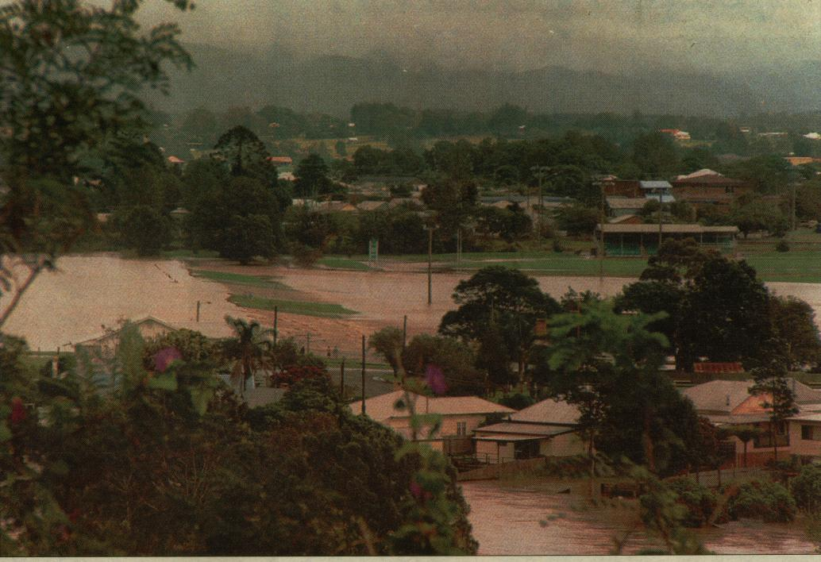
Other factors considered include:
Existing Flood Mitigation Measures
Levees (& overtopping behaviour)
Flood Gate & Flood Structure operations
Flood warning systems

Slide 18
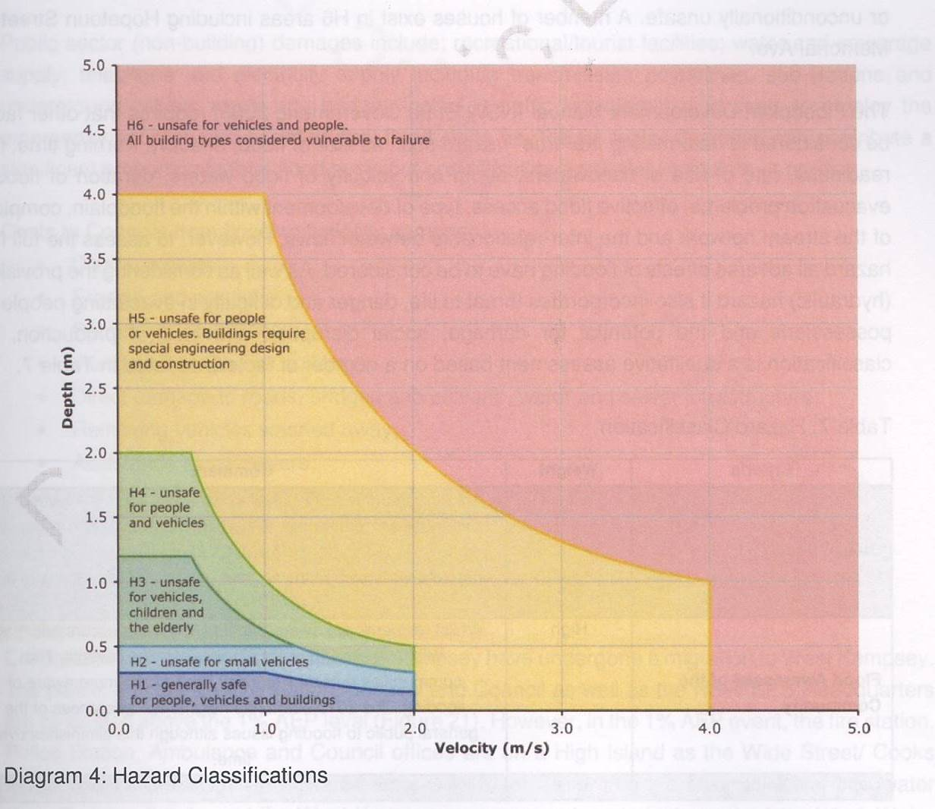
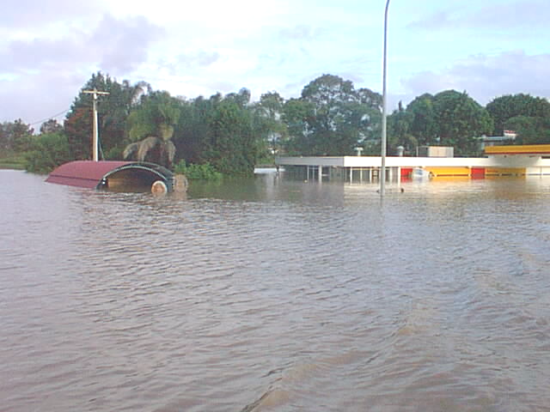
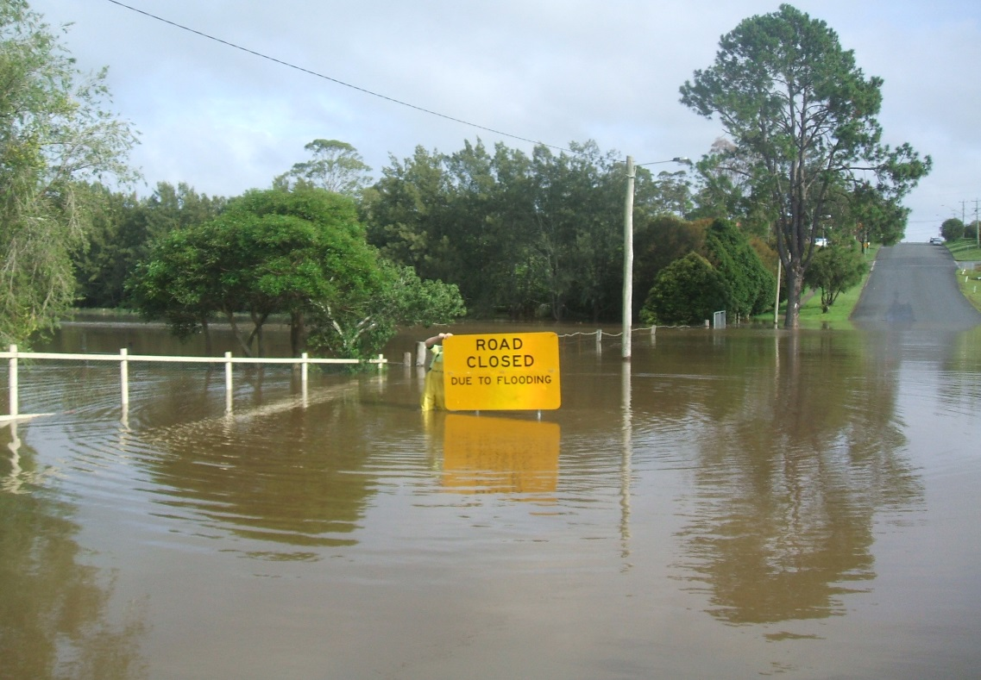
Other considerations:
Hydraulic & Hazard Classification
Impacts on public & private infrastructure
Impacts on properties and management
Emergency Response Management

Slide 19
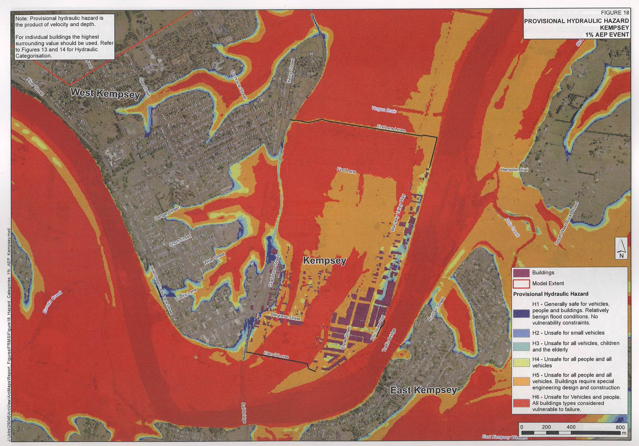
Model output – hazard mapping

Slide 20
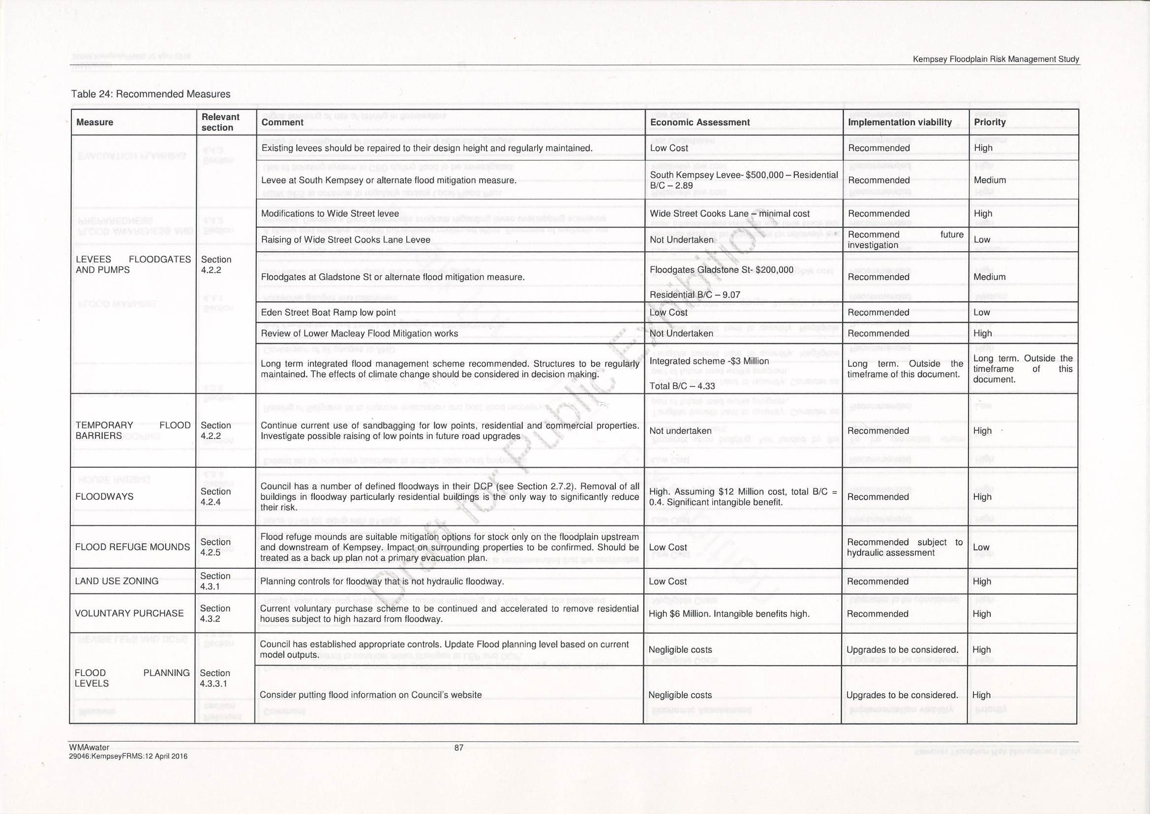
Recommendations for consideration

Slide 21
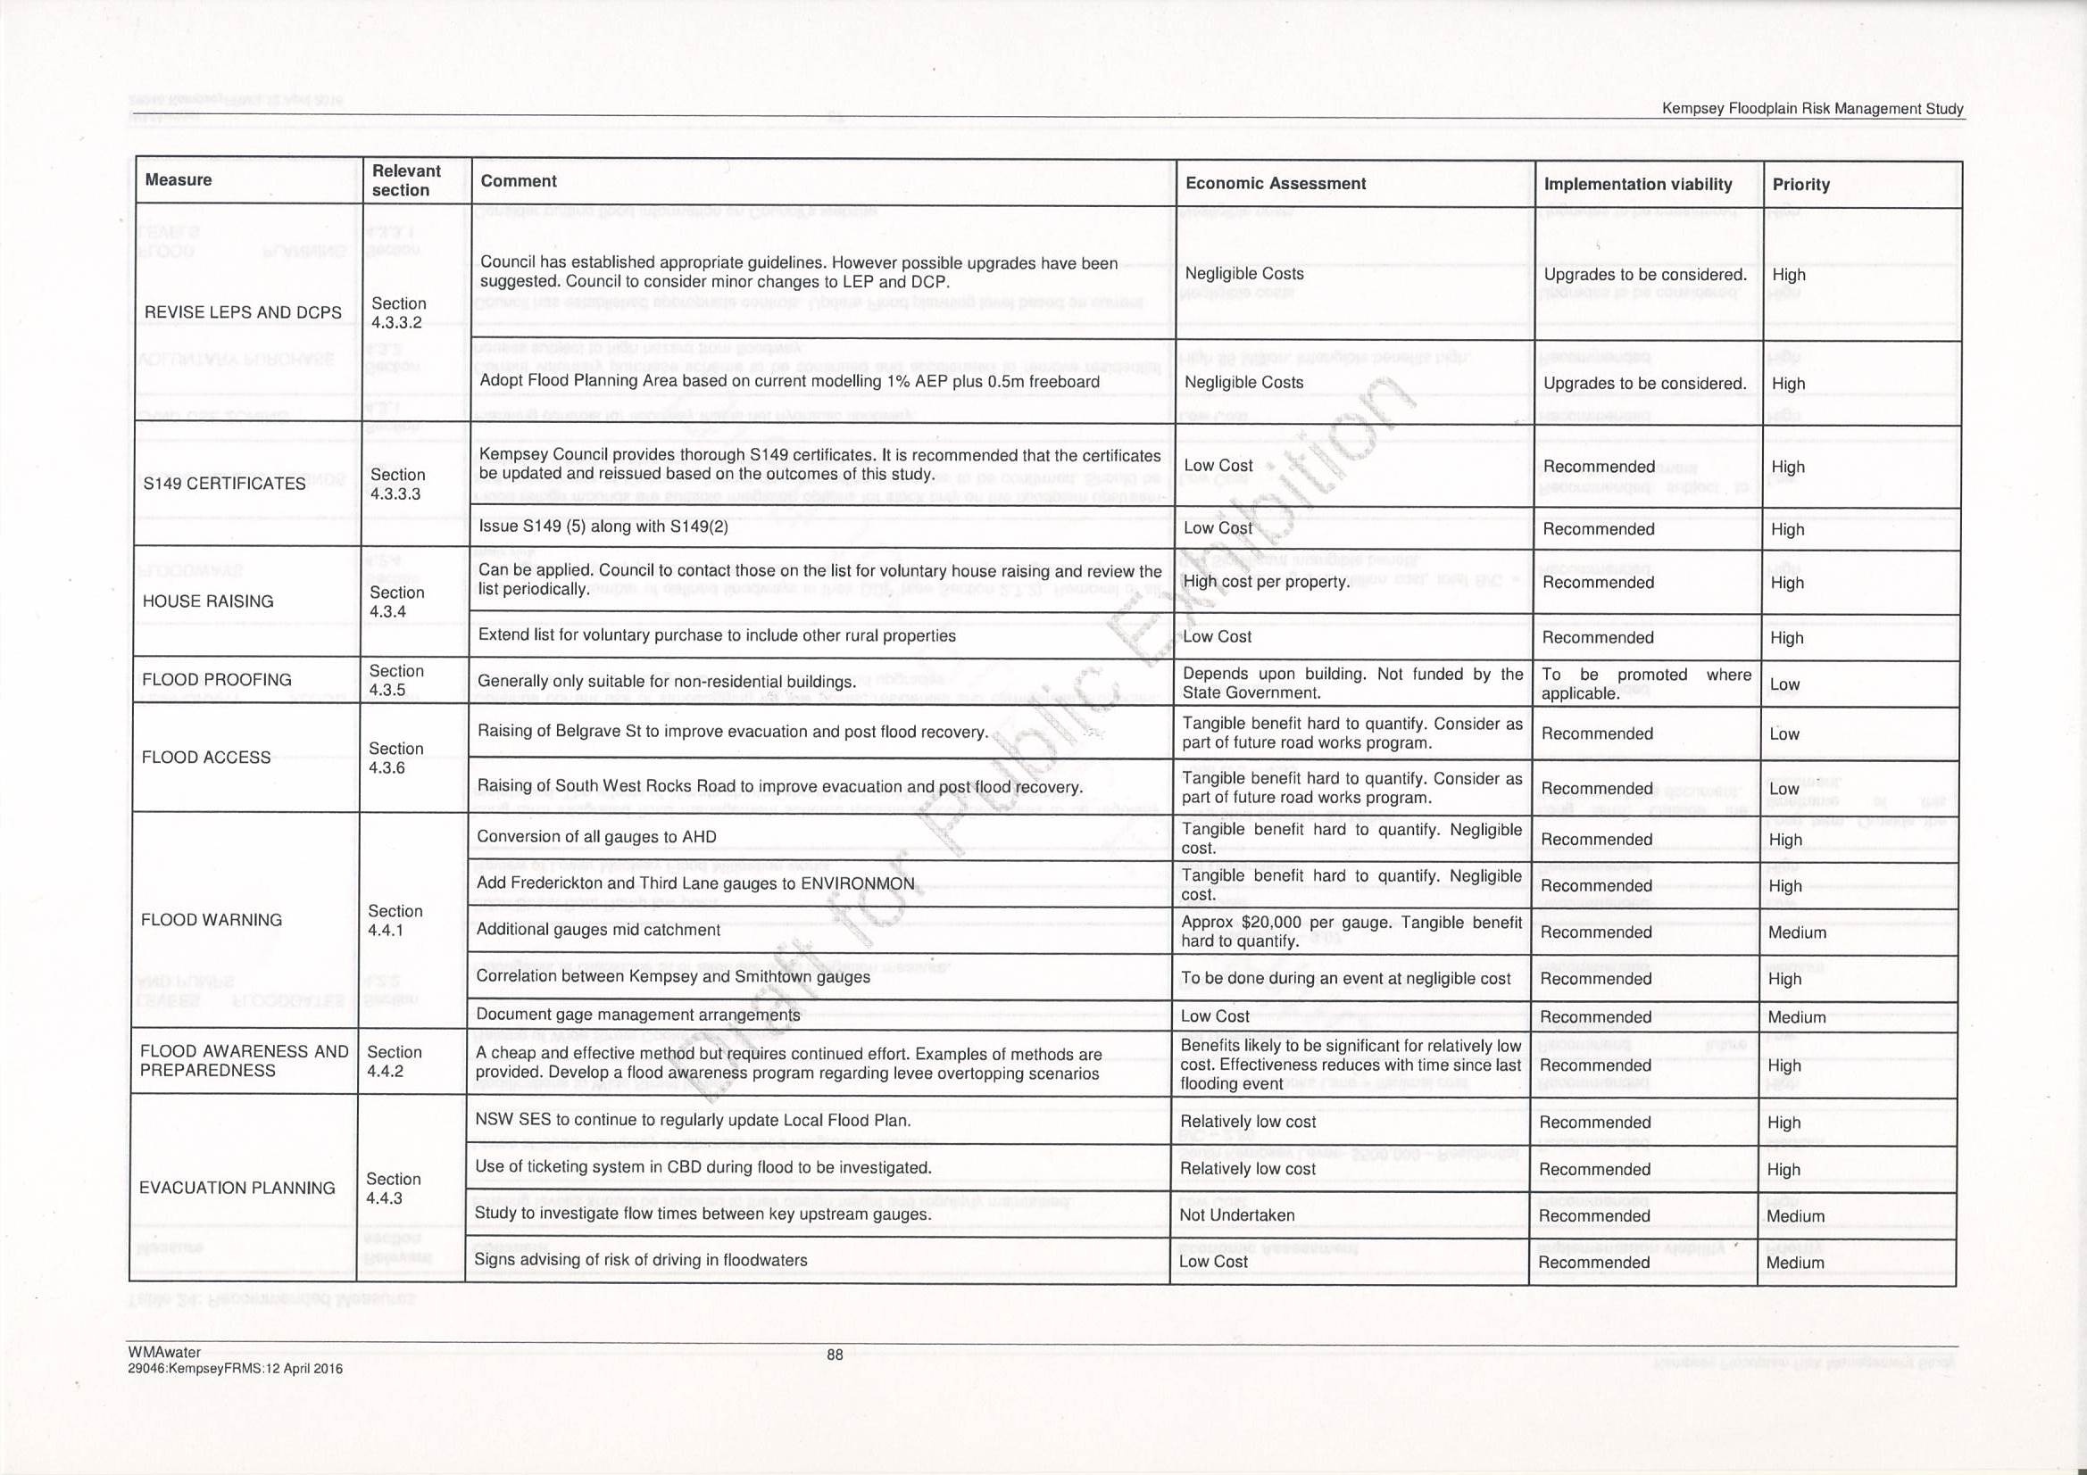
Recommendations for consideration

Slide 22
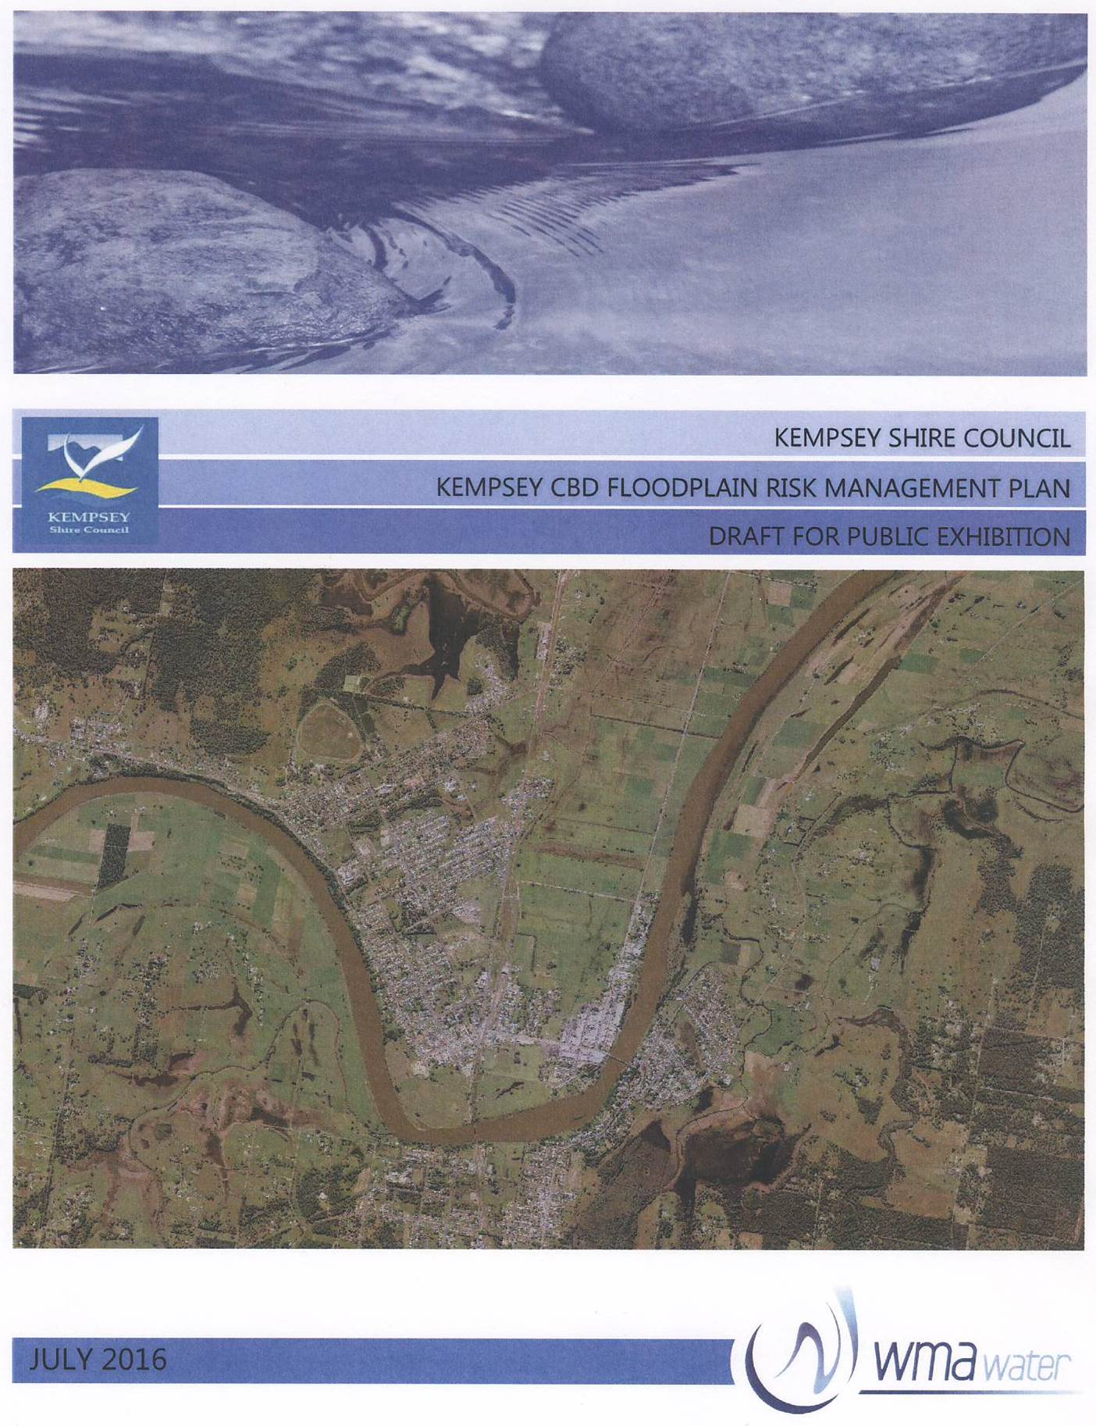
Stage 4: Floodplain Risk Management Plan (FRMP)
FRMP is the formalisation of the flood risk management process, with the aim of presenting prioritised and costed risk management measures.
Based on evaluation of all factors that affect and are affected by flood events
Represent considered opinion on how to best manage flood risk
Provides the basis for the future management of flood prone lands in the Kempsey CBD and surrounding urban area.

Slide 23
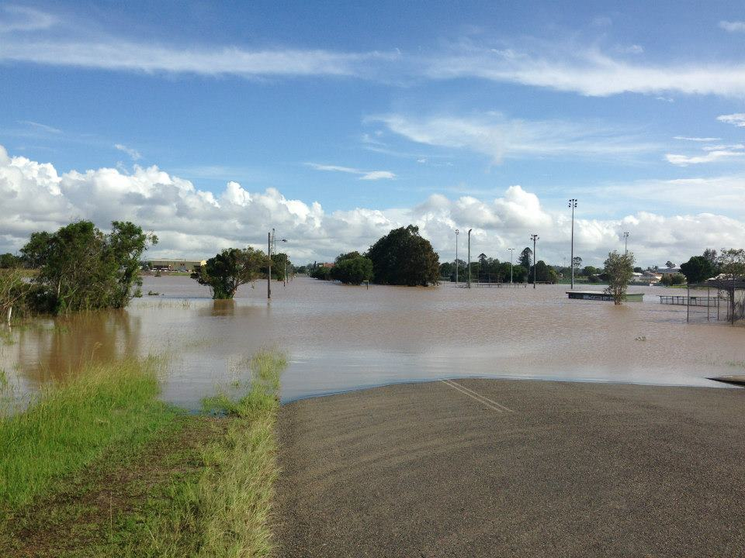
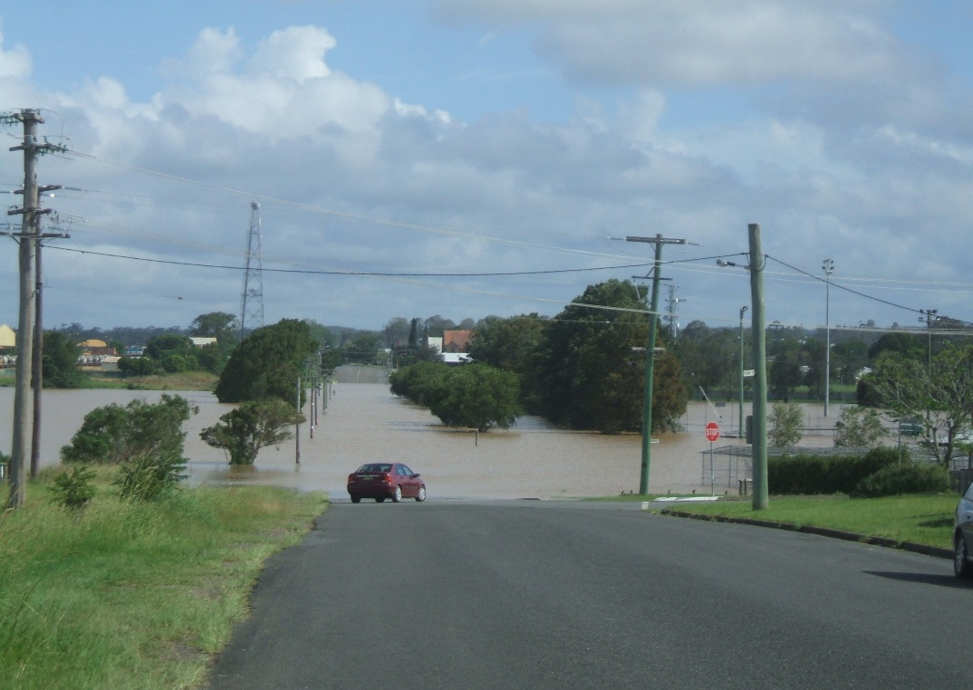
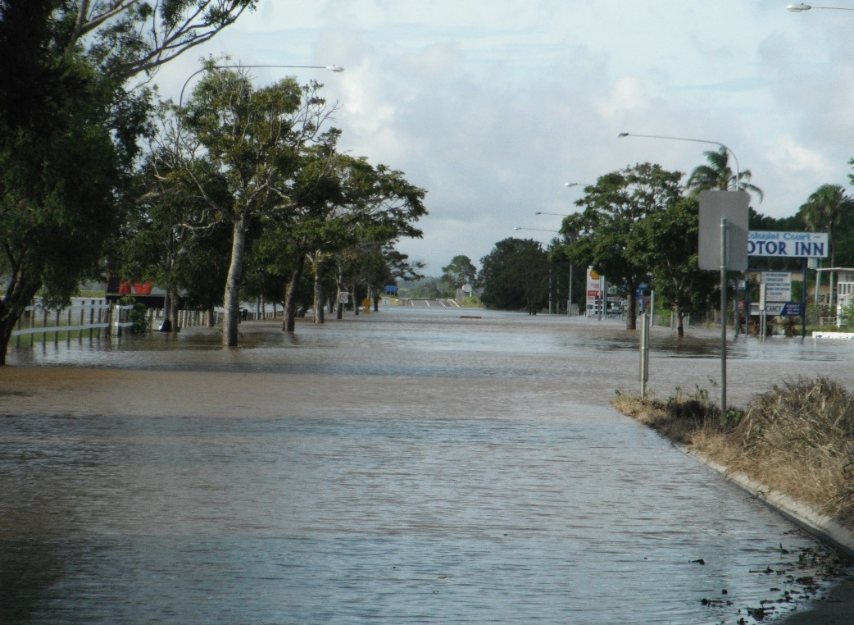
The FRMP presents the prioritised and costed flood risk management measures recommended for implementation within the Kempsey Study Area.

Slide 24
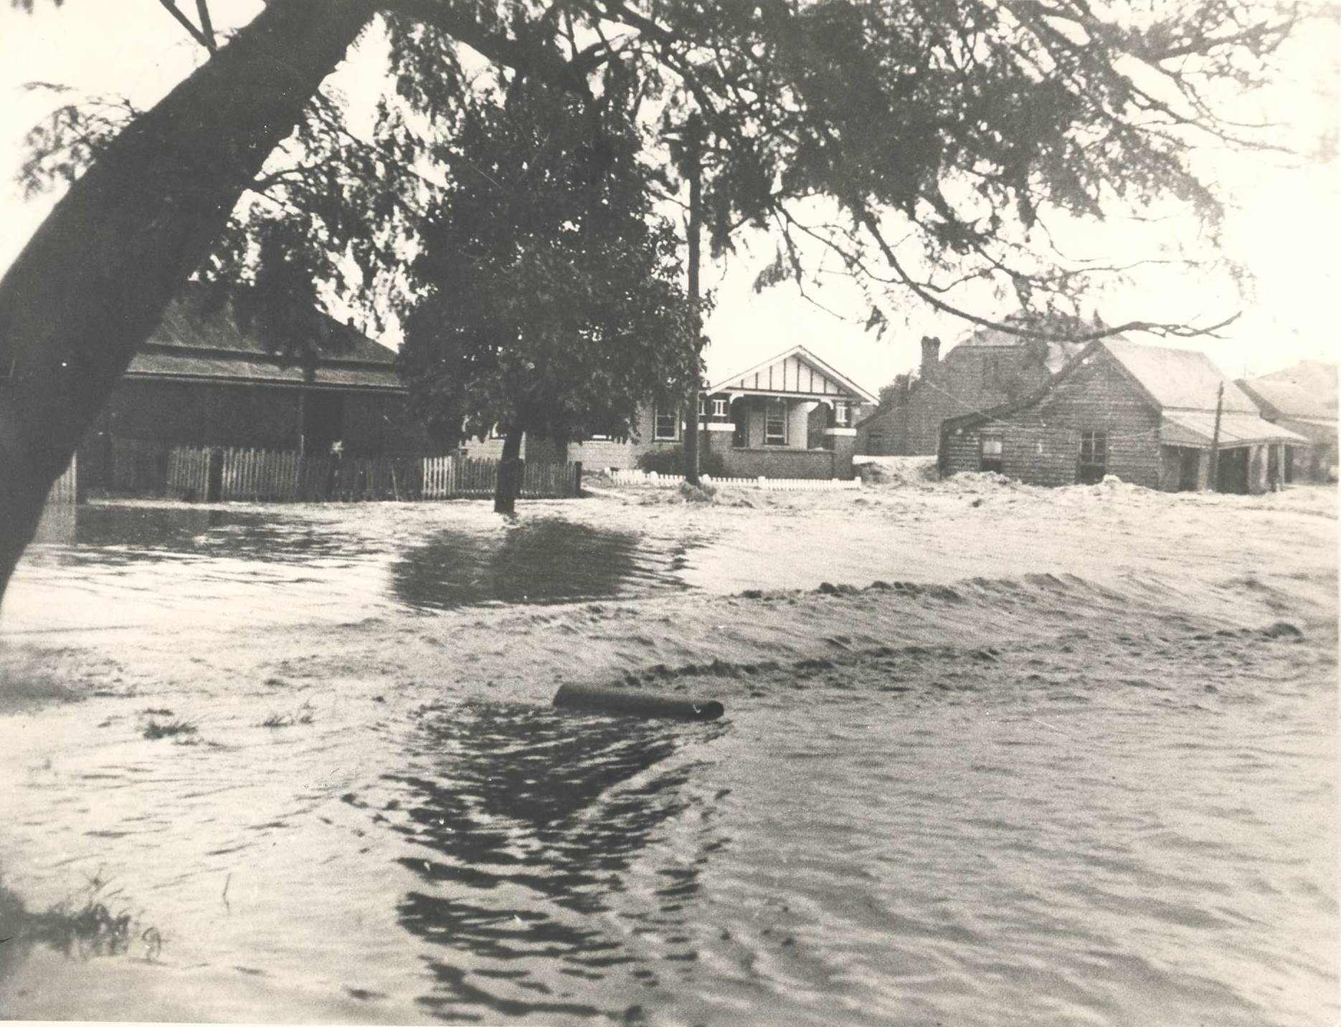
Management Options:
10 High Priority
2 Medium Priority, &
4 Low Priority
Physical (10)
Education/awareness (3)
Land use Planning (3)

Slide 25
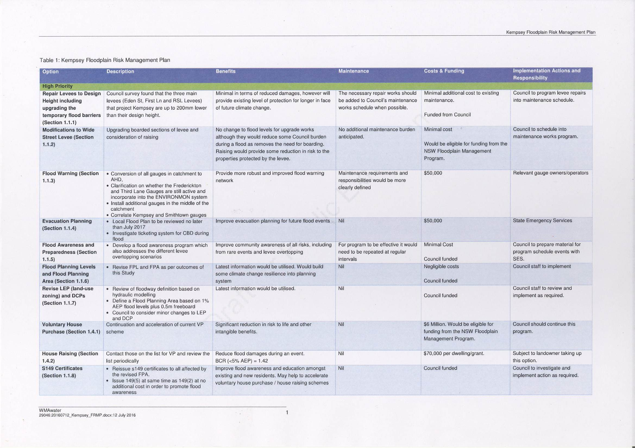

Slide 26
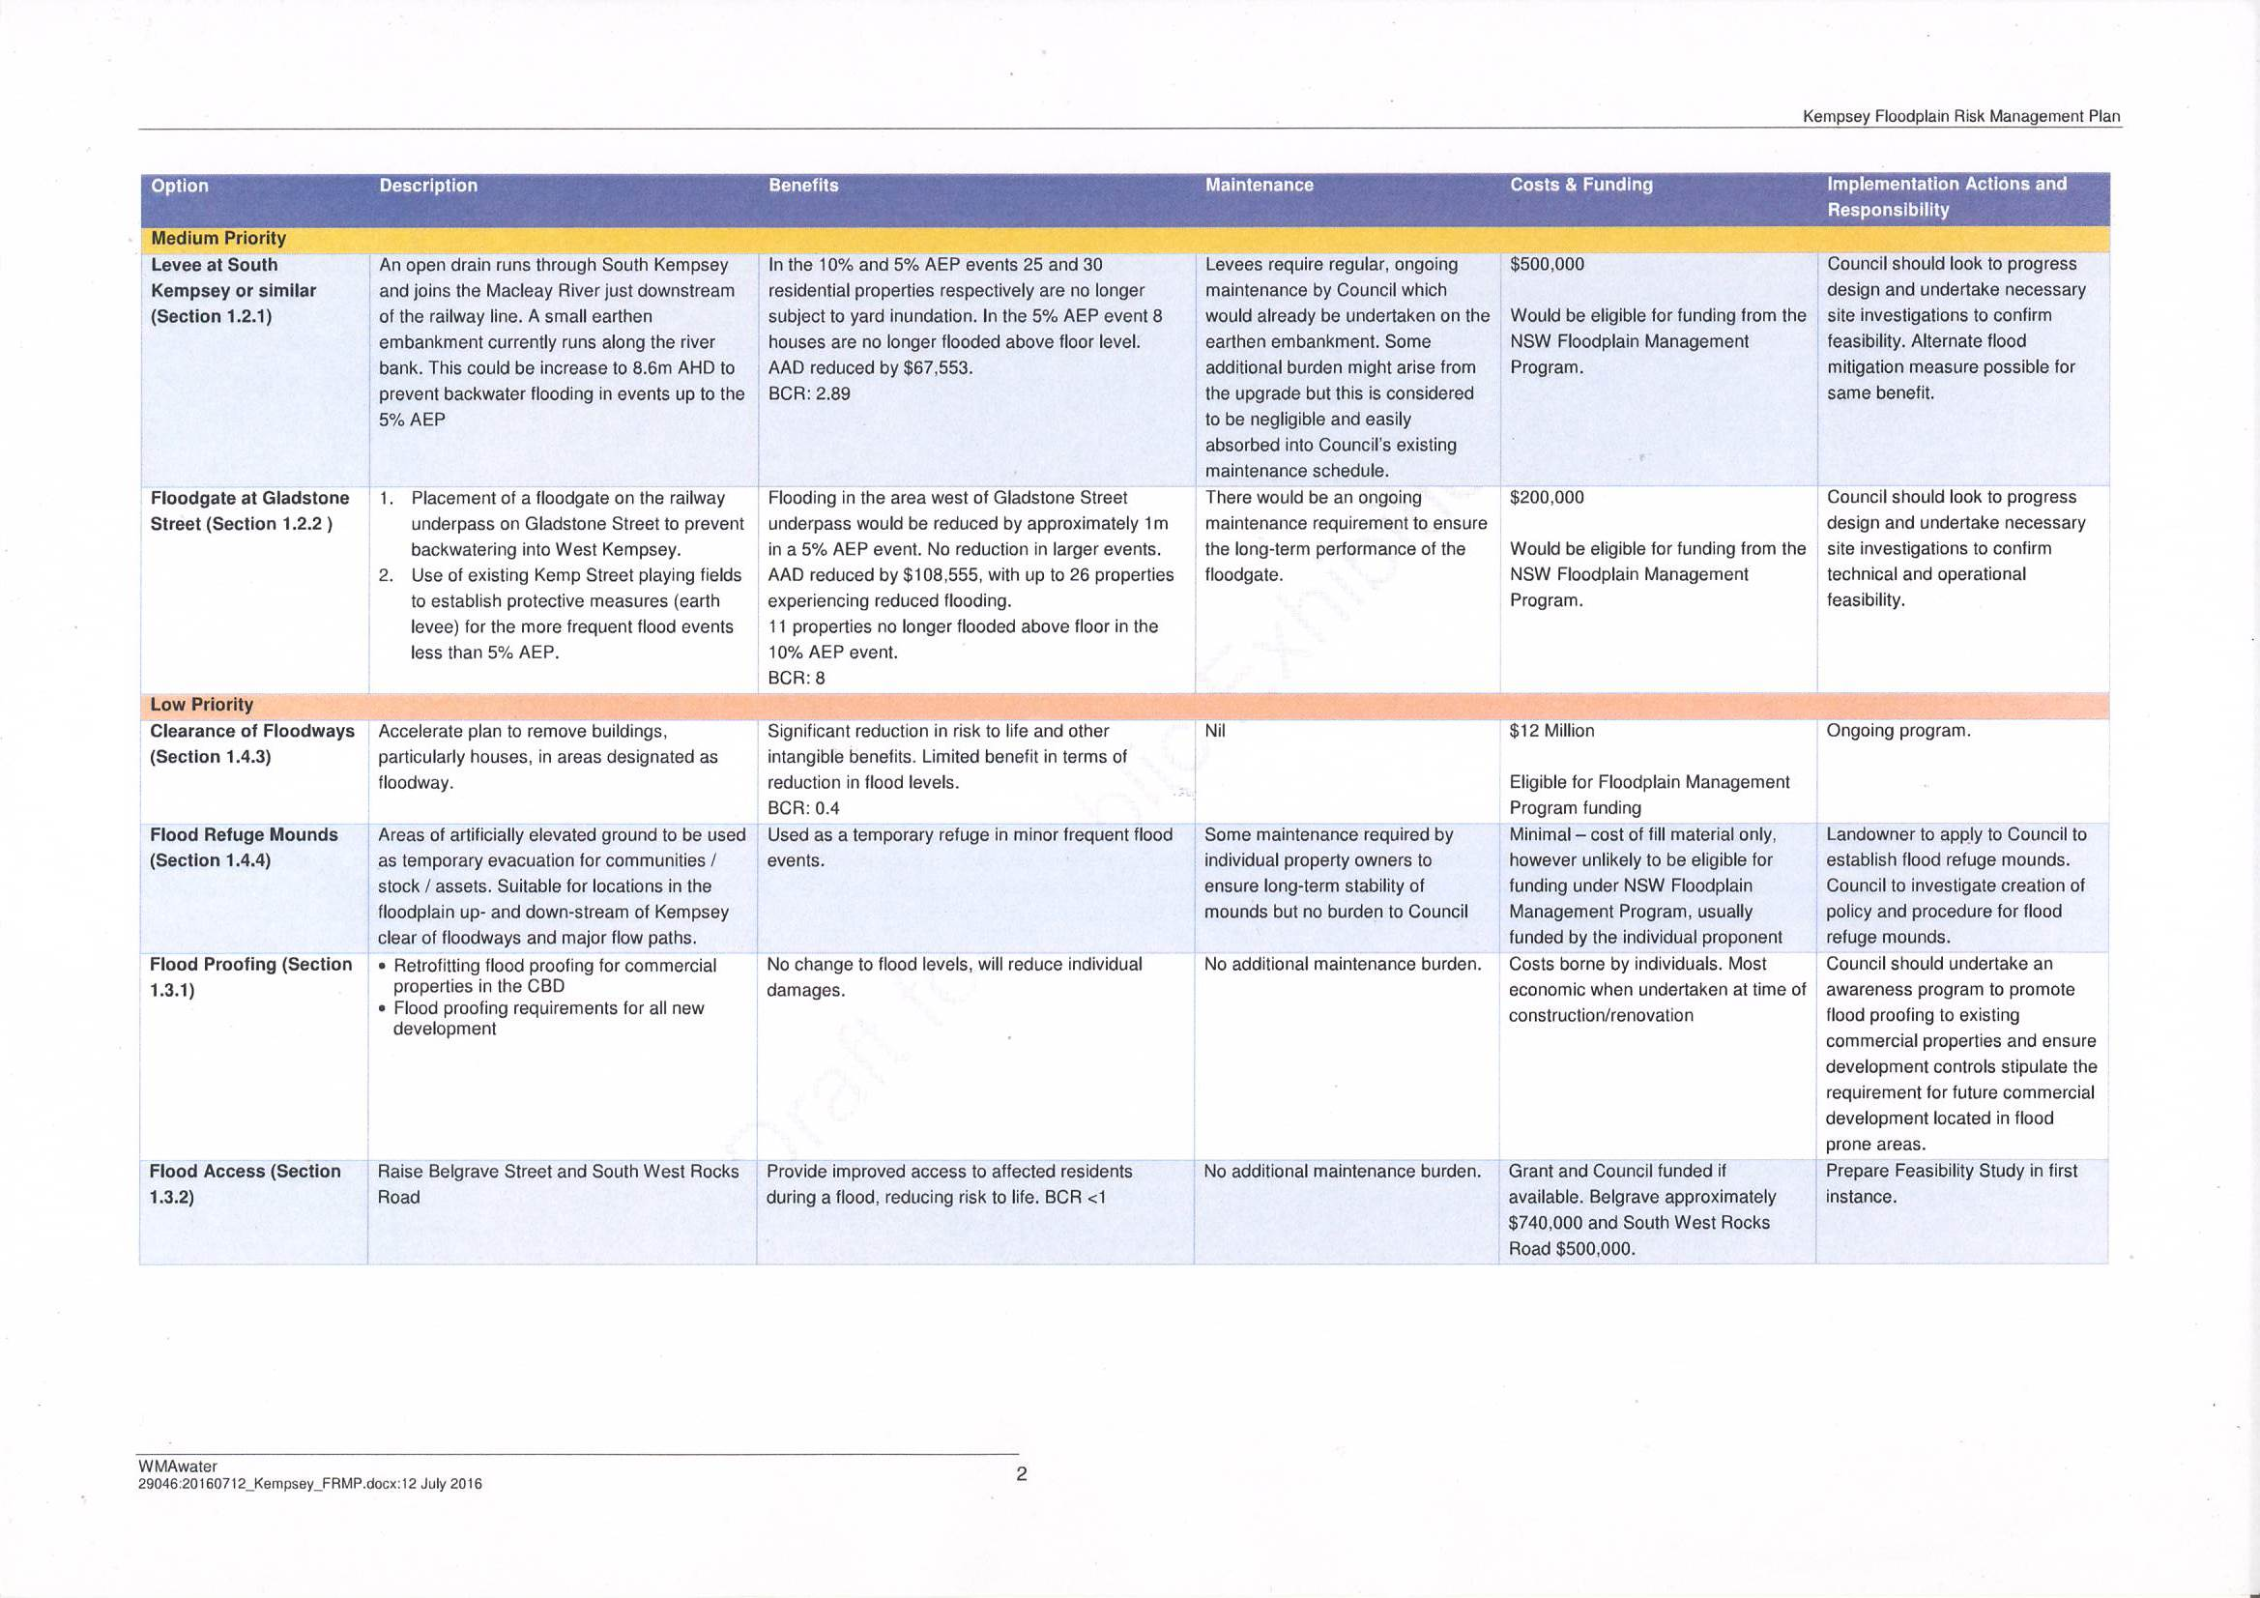

Slide 27

Where to from here ?:
Completed Public Exhibition of Draft Study & Plan
Collate and consider submissions
Finalise Kempsey Floodplain Risk Management Study & Plan
Prepare a Report to Council
Adoption of Flood Risk Study & Plan by Council
Commence implementation.

Slide 28
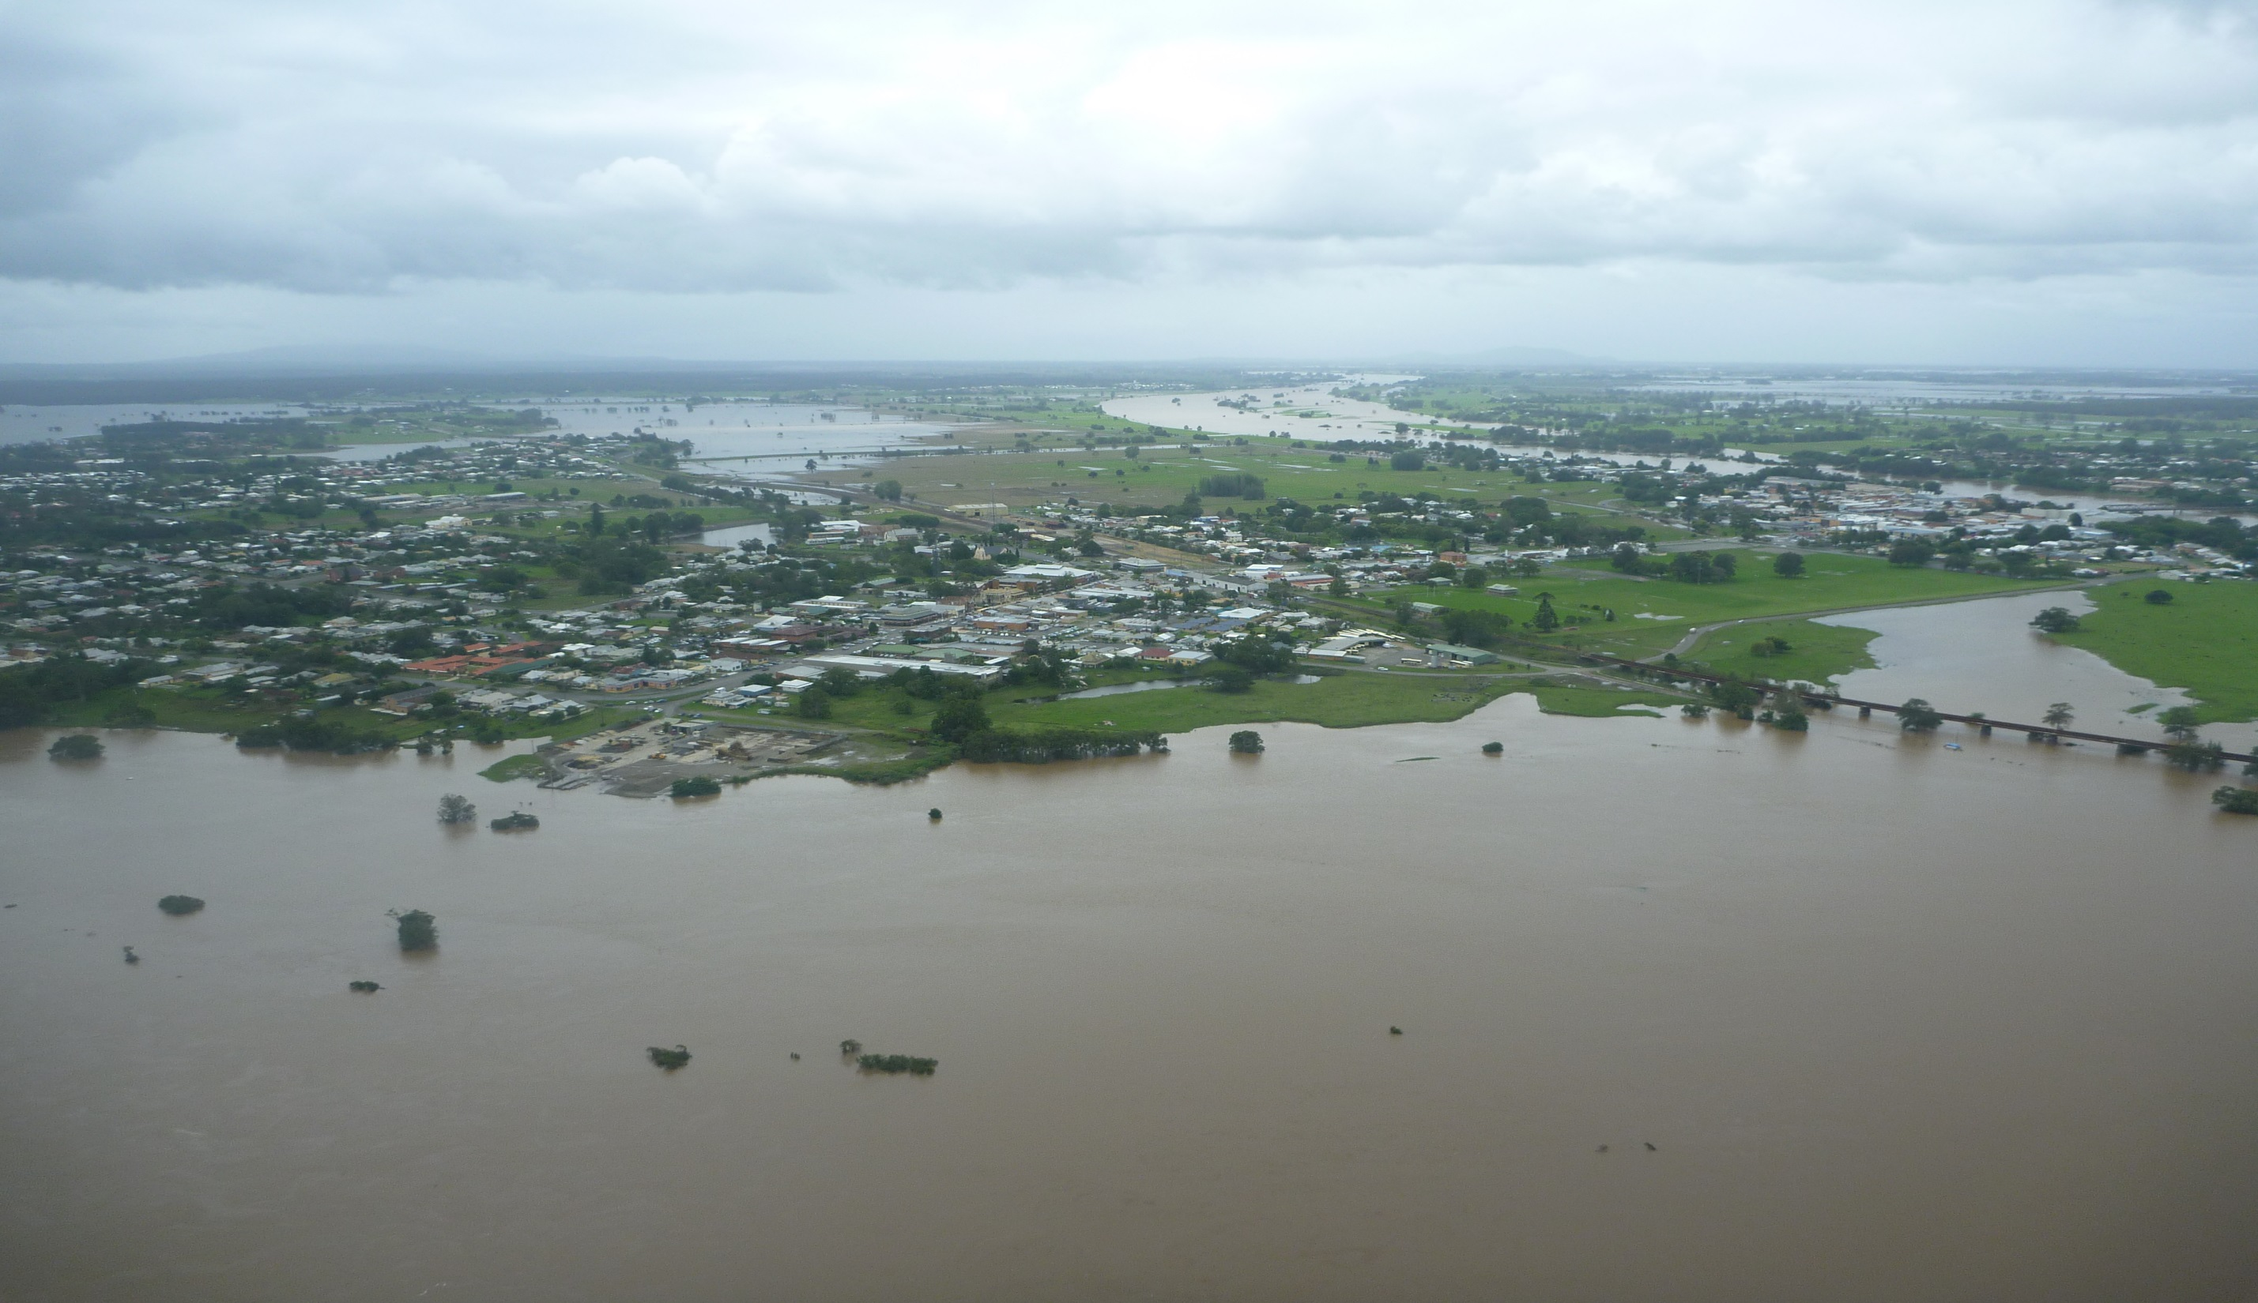
THE END

